Slide 1
Gas Turbine Theory and Construction

Slide 2
Introduction
Comprehend the thermodynamic processes occurring in a gas turbine
Comprehend the basic components of gas turbine engines and their basic operation
Comprehend the support systems associated with gas turbine engines

Slide 3
Background
Aircraft turbojet/turbofan engines are precursors to gas turbines
Installed for propulsion in:
  FFG’s
  DD’s
  DDG’s
  CG’s
  M-1 tanks
Also used for electrical generation & auxiliary applications

Slide 4
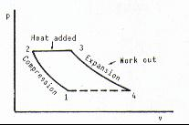
Brayton Cycle
Unlike diesels, operate on STEADY-FLOW cycle
Open cycle, unheated engine
1-2: Compression
2-3: Combustion
3-4: Expansion through Turbine and Exhaust Nozzle
(4-1: Atmospheric Pressure)

Slide 5
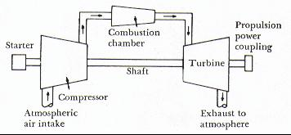
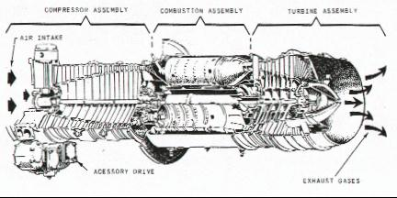
Basic Components

Slide 6
Basic Components

Slide 7
Basic Components
Compressor
  Draws in air & compresses it
Combustion Chamber
  Fuel pumped in and ignited to burn with compressed air
Turbine
  Hot gases converted to work
  Can drive compressor & external load

Slide 8
Basic Components
Compressor
  Draws in air & compresses it
Combustion Chamber
  Fuel pumped in and ignited to burn with compressed air
Turbine
  Hot gases converted to work
  Can drive compressor & external load

Slide 9
Basic Components
Compressor
  Draws in air & compresses it
Combustion Chamber
  Fuel pumped in and ignited to burn with compressed air
Turbine
  Hot gases converted to work
  Can drive compressor & external load

Slide 10
Compressor
Supplies high pressure air for combustion process
Compressor types
  Radial/centrifugal flow compressor
  Axial flow compressor

Slide 11
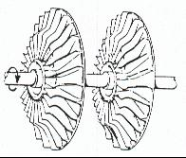
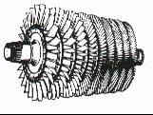
Compressor
Radial/centrifugal flow
  Adv: simple design, good for low compression ratios (5:1)
  Disadv: Difficult to stage, less efficient
Axial flow
  Good for high compression ratios (20:1)
  Most commonly used

Slide 12
Compressor
Controlling Load on Compressor
  To ensure maximum efficiency and allow for flexibility, compressor can be split into HP & LP sections
  Vane control: inlet vanes/nozzle angles can be varied to control air flow
Compressor Stall
  Interruption of air flow due to turbulence

Slide 13
Use of Compressed Air
Primary Air (30%)
  Passes directly to combustor for combustion process
Secondary Air (65%)
  Passes through holes in perforated inner shell & mixes with combustion gases
Film Cooling Air (5%)
  Insulates/cools turbine blades

Slide 14
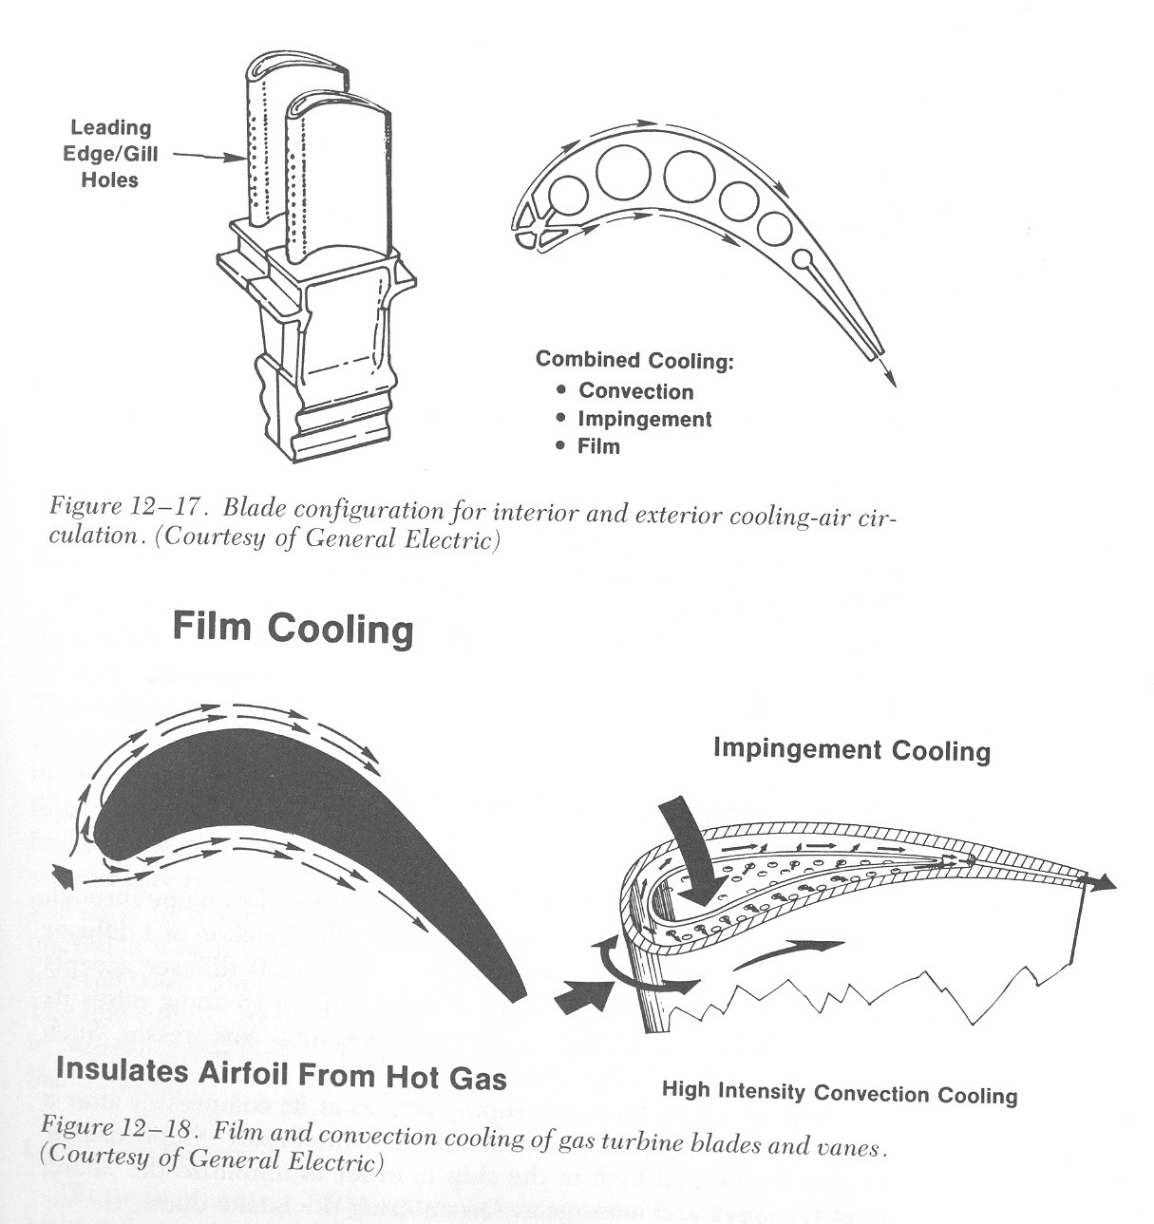
Blade Cooling

Slide 15

Combustion Chambers
Where air & fuel are mixed, ignited, and burned
Spark plugs used to ignite fuel
Types
  Can: for small, centrifugal compressors
  Annular: for larger, axial compressors (LM 2500)
  Can-annular: rarely used

Slide 16
Turbines
Consists of one or more stages designed to develop rotational energy
Uses sets of nozzles & blades
Single shaft
  Power coupling on same shaft as turbine
  Same shaft drives rotor of compressor and power components

Slide 17
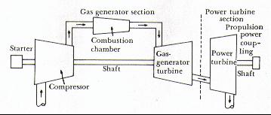
Turbines
Split Shaft
  Gas generator turbine drives compressor
  Power turbine separate from gas generator turbine
  Power turbine driven by exhaust from gas generator turbine
  Power turbine drives power coupling

Slide 18
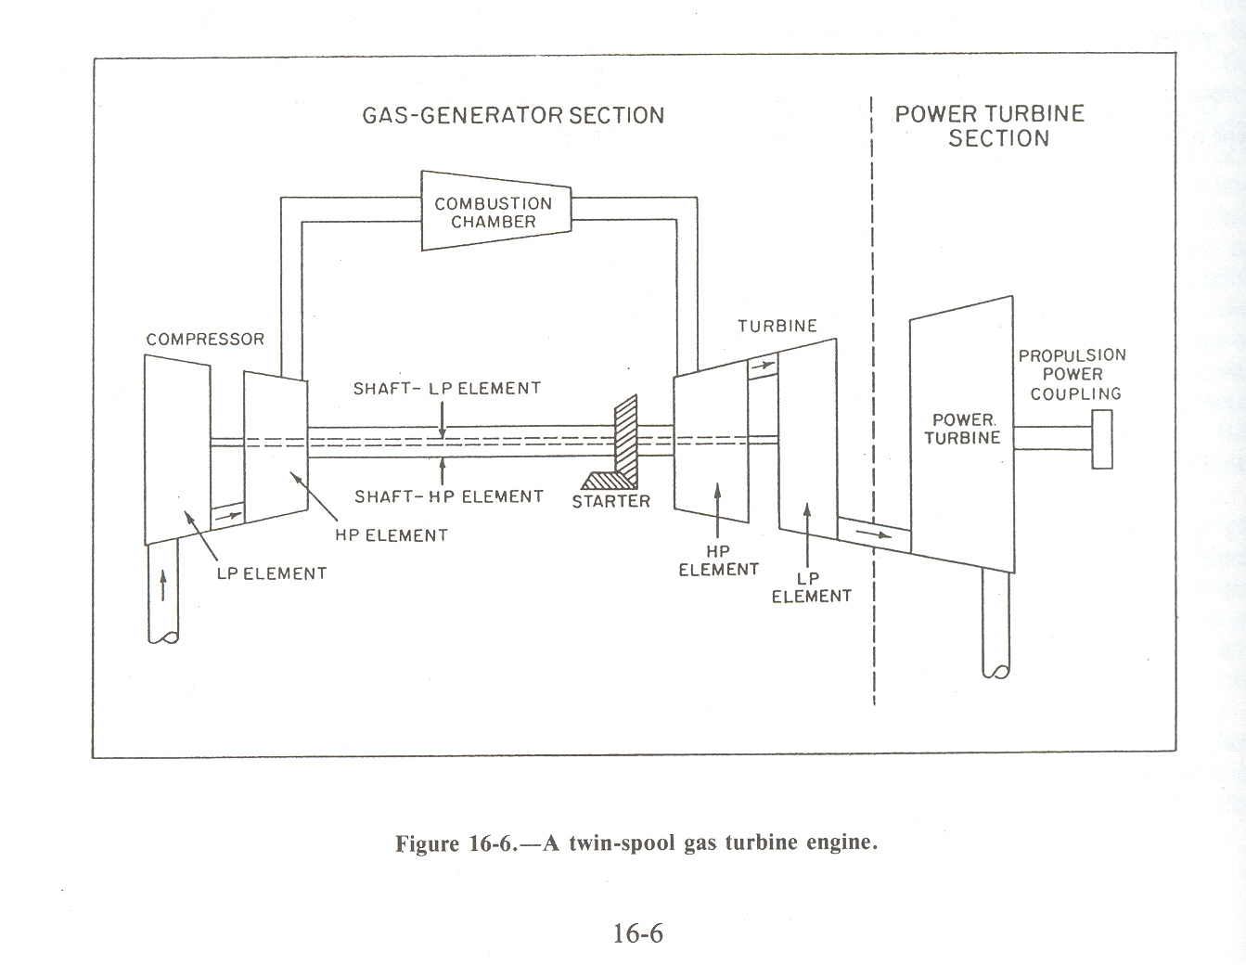
Dual Shaft, Split Shaft

Slide 19
Gas Turbine Systems
Air System
  Air intakes are located high up & multiple filters
  Exhaust discharged out stacks
Fuel System
  Uses either DFM or JP-5
Lubrication System
  Supply bearings and gears with oil

Slide 20
Gas Turbine Accessory Systems
Starting System
  To get compressor initially rotated, HP air used (can use electrical also)
  Once at certain RPM, fuel injected and spark ignited
Power Transmission System
  Reduction gears used to transfer torque
  With split shaft, turbines can run @ different speeds

Slide 21
GTG vs Steam
For the same hP,
  Weight reduction of 70%
  Simpler (less maintenance, fewer components)
  Reduced manning – automated control
  Quicker response time
  Modular replacement

Slide 22
Engine Power Transfer
Turbojet
    Thrust provided by reaction against expansion of exhaust gases
Turbofan
    Thrust provided by reaction against expansion of large volumes of air
Marine systems
    Thrust provided by turbine
SCRAMjet/RAMjet

Slide 23


Slide 24
What’s Important
Block Diagram of Split-Shaft GTG system
Types of Compression and characteristics
Major difference between aviation and marine GTs

Slide 25
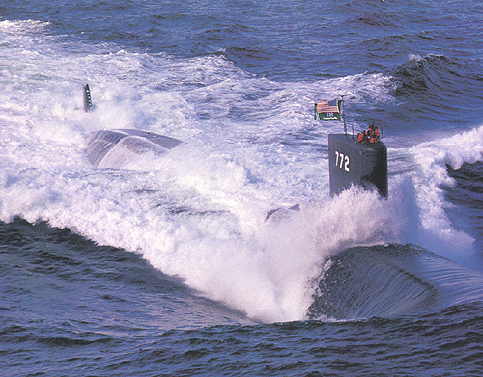
Questions?

