Slide 1
BASIC ELECTRICAL ENGINEERING

Slide 2
ELECTRICAL ENGINEERING
Engineering is a systematic enterprise that is concerned with the application of scientific, economic , social, and practical knowledge in order to design , build, and maintain structures, machines, devices, systems, materials and processes.
Electrical engineering is a field of engineering that generally deals with the study and application of electricity, electronics, and electromagnetism.

Slide 3
ADVANTAGES OF ELECTRICAL ENERGY
Its called "Clean and Green energy"
It can be easily converted to other form of energy.
It is much cheaper than other forms of energy.
It can be easily transmitted to various location very conveniently and efficiently.
This form of energy can be controlled and monitored easily.

Slide 4
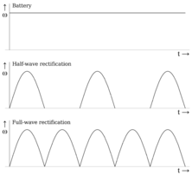
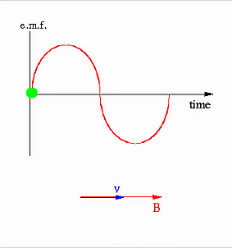
Electrical Systems
Current current flow is created when voltage moves electrons through a conductor.
This flow is measured in Amperes
Must be a complete circuit before the current can flow.
DC Direct Current flow (Automotive)
AC Alternating Current it changes its direction of flow (House)

Slide 5
Properties of Electric Current
Heating Property: Whenever current flows through any conducting material it heats the material.
Magnetic Property: When current flows through a conductor produces magnetic field.
Electro-Chemical Property: Whenever current passes through electrolyte it produces chemical reaction.

Slide 6



Electrical Systems
Voltage is a measurement of the pressure that causes the electrical
energy(Current) to flow.
Same as water through pipe.
No movement unless force or pressure is applied.
Is measured in Volts (V) and the symbol is E

Slide 7
Electrical Systems
POWER of a machine is the rate of doing work.
  Unit of power in electricity is Watt.
ENERGY of a body is the capacity for doing work.
  Electrical energy is generally expressed in Joules or
    in kilowatt hour.

Slide 8
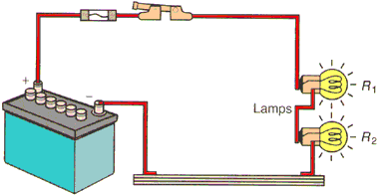
ELECTRICAL CIRCUITS
SERIES CIRCUIT
  Power source and loads are in series.
  If the path is broken, no current flows. (Christmas lights)
  Voltage is divided between the loads.
    Current flow is same throughout the circuit.
  The resistance of each load can be different.

Slide 9
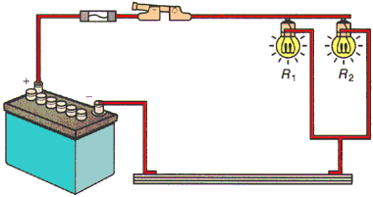
ELECTRICAL CIRCUTS
PARALLEL CIRCUIT
  More then one path for current flow.
  In the event of an open in one branch, current will continue to flow
through the remaining.
    Each branch receives source voltage.
  Current flow and resistance of each branch could be different.

Slide 10
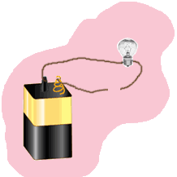
Electrical Systems
Open Circuit
When the electrical path is broken.
Stops current flow and prevents operation of device.
Reasons
Burned fuse
Light bulbs
Broken wires
Defective switch

Slide 11
Over Current Protection
The most fundamental requirement in any electrical system is proper overcurrent protection of conductors and equipment
An overcurrent protection device protects the circuit by opening the device when the current reaches a value that will cause an excessive or dangerous temperature rise in conductors

Slide 12
Over Current Protection
Fuses and circuit breakers are installed in electrical circuits to protect it from over current.
Fuses and circuit breakers respond and open for both low and high values of overcurrent flow through the circuit.

Slide 13
FUSES
Fuse is a safety device.
Fuses contain an element that acts like a conductor for the normal current flow. The element’s ability to sense abnormal current is the basis for the amp rating of the fuse.
When an overcurrent develops that exceeds the fuse rating, heat builds up inside the fuse and melts or “opens” the element. Once the element is melted and the arc extinguished, current flow stops.

Slide 14
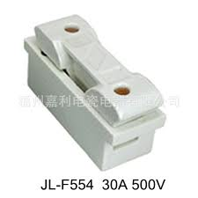
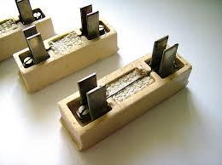
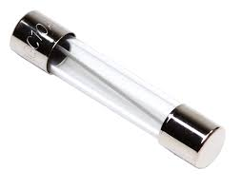
FUSES
When the overload or fault condition that caused the fuse to open is corrected, a proper replacement fuse restores the original dependable protection.

Slide 15
CIRCUIT BREAKERS
Circuit breaker - automatically operated electrical switch designed to protect an electrical circuit from damage caused by overload or short circuit. Its basic function is to detect a fault condition and interrupt current flow.
Unlike a fuse, which operates once and then must be replaced, a circuit breaker can be reset (either manually or automatically) to resume normal operation.

Slide 16
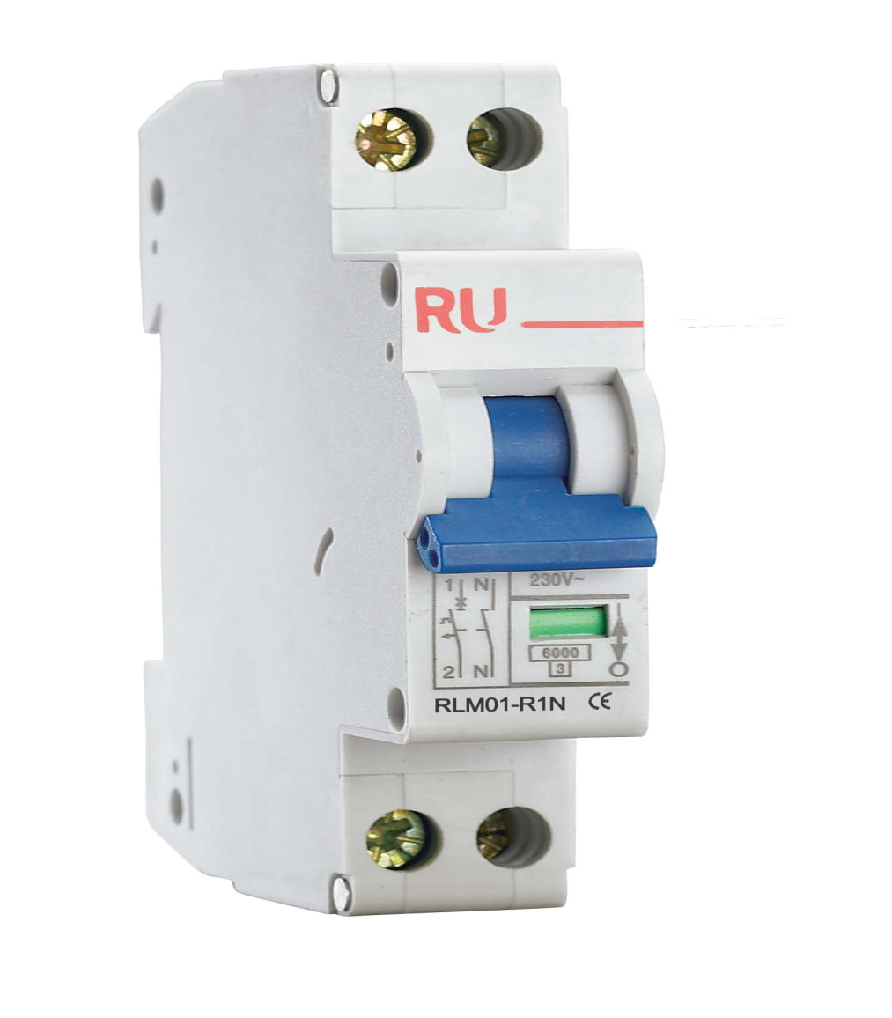
MINIATURE CIRCUIT BREAKER
Rated current not more
than 100 A.
Trip characteristics
normally not adjustable.
Thermal or
thermal-magnetic
operation

Slide 17
EARTH LEAKAGE CIRCUIT BREAKER
Phase (line), Neutral and Earth wire connected through ELCB.
ELCB is working based on Earth leakage current.
Operating Time of ELCB:
  The safest limit of Current which Human Body can withstand is 30ma sec.
  Suppose Human Body Resistance is 500Ω and Voltage to ground is 230 Volt.
  The Body current will be 500/230=460mA.
  Hence ELCB must be operated in 30maSec/460mA = 0.65msec

Slide 18
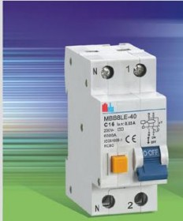
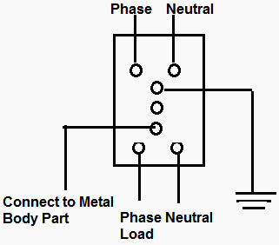
EARTH LEAKAGE CIRCUIT BREAKER
ELCB Typical Circuit
diagram

Slide 19
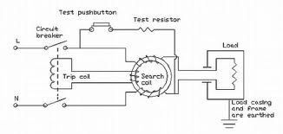
PRINCIPLE OF OPERATION

Slide 20
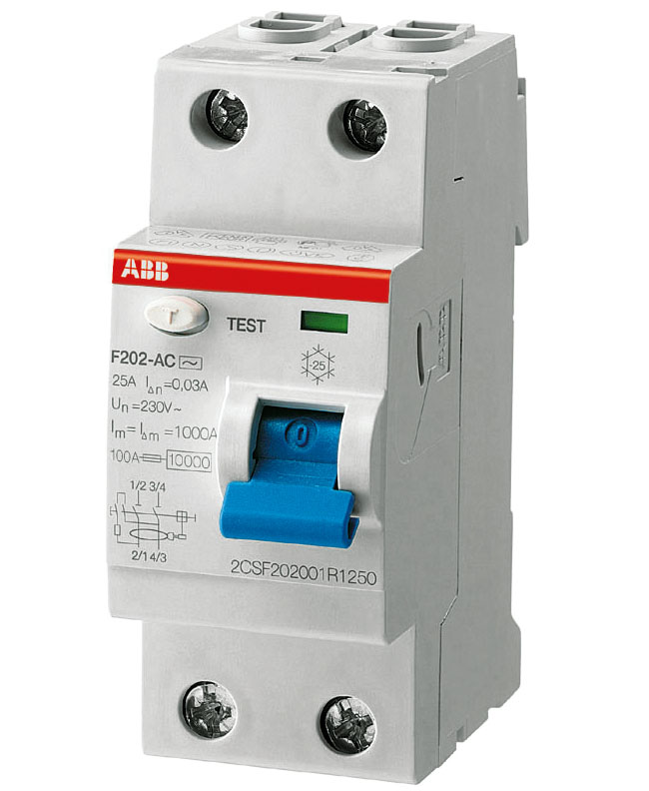
RESIDUAL CIRCUIT BREAKER
RCB stands for residual circuit
breaker which provides protection
against earth fault as well as over current.
It monitors the current difference
between phase and neutral and if
the difference is more than rated
value say 200 milli amps it will trip.

Slide 21
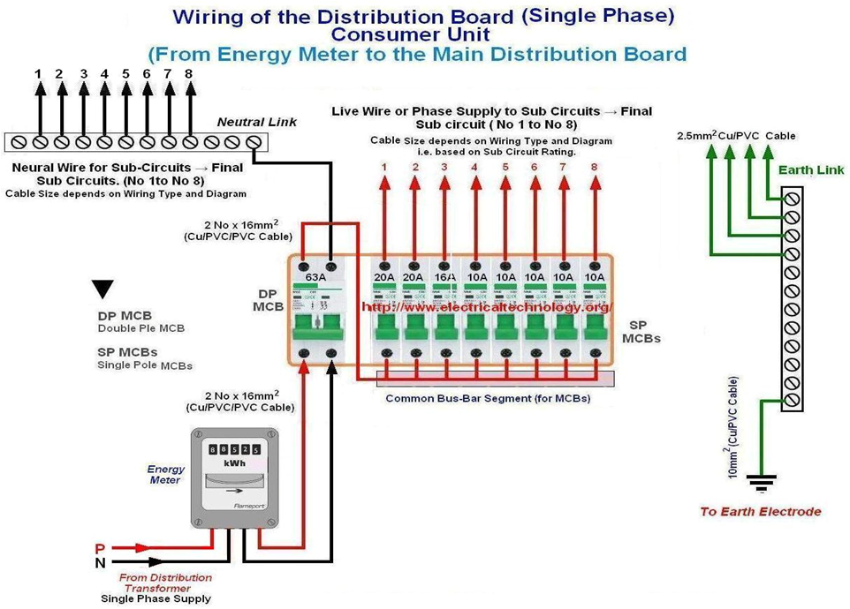

Slide 22
ELECTRICAL WIRING ESTIMATING AND COSTING

Slide 23
PURPOSE OF ESTIMATING AND COSTING
Cost of wiring materials used.
Accessories required and their cost.
Labour cost.
Overhead expenses and profit of the contractor.

Slide 24
ESSENTIAL ELEMENTS OF ESTIMATING AND COSTING
Latest market cost of material
Price list and net prices
Calculation of material and labour cost
Specification of material

Slide 25
WIRING SYSTEM
A network of wire connecting various accessories for distribution of electrical energy.
TYPES OF WIRING
    Surface Conduit wiring
    Concealed Conduit wiring
    Casing and Capping wiring
    TRS wiring
    Cleat wiring

Slide 26
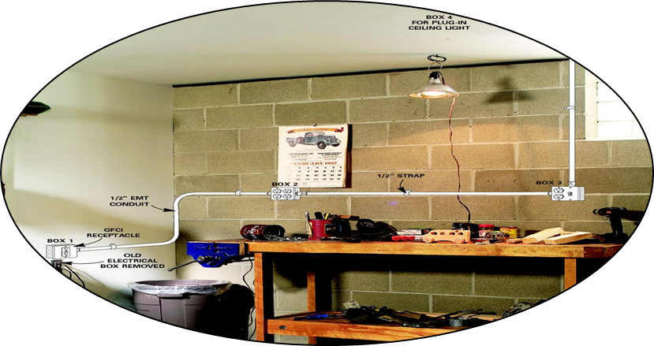
CONDUIT WIRING
In general, a conduit is defined as a tube or channel. Tubular conduit is the most commonly used material in electrical installations. When cables are drawn through the conduit and terminated at the outlet or switch points, the system of wiring is called conduit wiring.

Slide 27
CONDUIT WIRING
There are four types of conduits used for wiring.
  Rigid steel conduit
  Rigid non-metallic conduit
  Flexible steel conduit
  Flexible non metallic conduit.

Slide 28
CASING AND CAPPING WIRING
This system of wiring is suitable for low voltage installation, in this wiring, cables like vulcanized rubber, insulated cables or plastic insulated cables are use and carried within the wood casing enclosures.
The wood casing wiring system shall not be use in damp places and in ill-ventilated places, unless suitable precautions are taken.

Slide 29
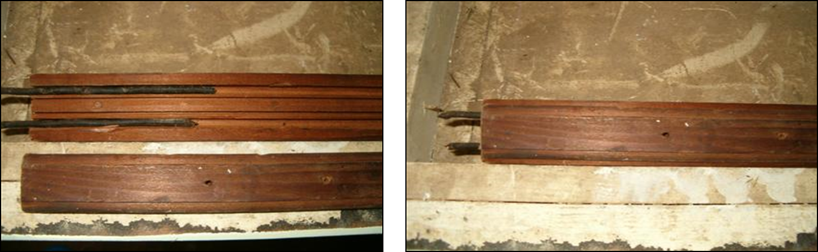
CASING AND CAPPING WIRING
All casing shall be of first class, seasoned teak wood or any other approved hardwood free from knots, shakes, saps or other defects, with all the sides planed to a smooth finish, and all sides well varnished, both inside and out side with pure shellac varnish. The casing shall have a grooved body with a beaded or plain- molded cover as desired.

Slide 30
CLEAT WIRING
Cleat wiring is recommended only for temporary installations.
The cleats are made in pairs having bottom and top halves.
The bottom half is grooved to receive the wire and the top half is for cable grip.
Initially the bottom and top cleats are fixed on the wall loosely according to the layout.
Then the cable is drawn, tensioned and the cleats are tightened by the screw.
Cleats are of three types, having one, two or three grooves, so as to receive one, two or three wires.

Slide 31
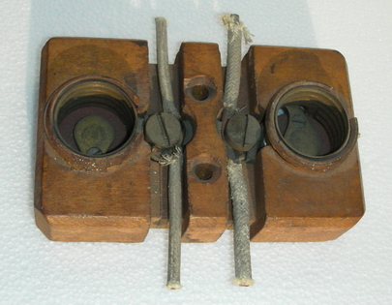
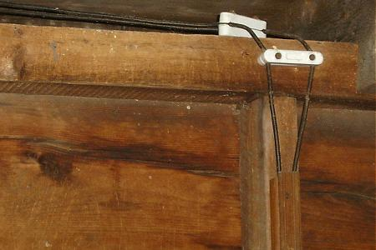
CLEAT WIRING
Wooden cleats.

Slide 32

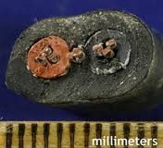
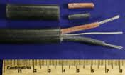
TRS WIRING
Tough Rubber Sheath cable normally consists of a black outer sheath of rubber with several conductors.

Slide 33
EARTHING

Slide 34
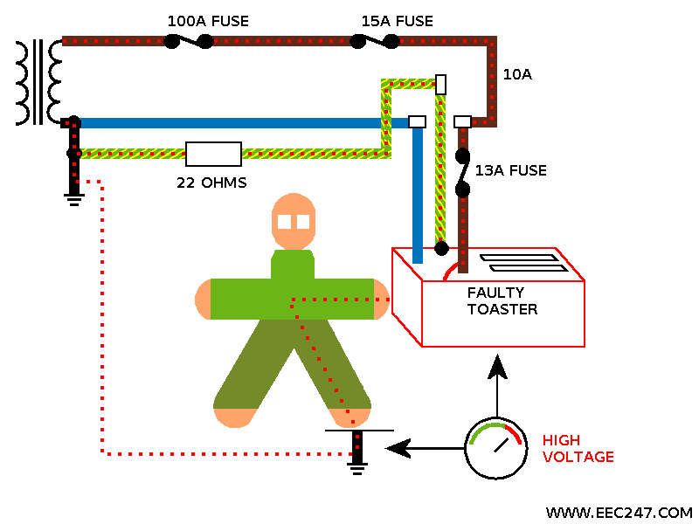
What is Earthing ?
The process of connecting metallic bodies of all the electrical apparatus and equipment to huge mass of earth by a wire having negligible resistance is called Earthing.

Slide 35
Objectives of Earthing
Provide an alternative path for the fault current to flow so that it will not endanger the user.
Ensure that all exposed conductive parts do not reach a dangerous potential .
Maintain the voltage at any part of an electrical system at a known value so as to prevent over current or excessive voltage on the appliances or equipment.

Slide 36
Good Earthing
Good Earthing must have low impedance enough to ensure that sufficient current can flow through the safety device so that it disconnects the supply ( <0.4 sec ).
Fault current is much more than the full load current of the circuit which melts the fuse.
Hence, the appliance is disconnected automatically from the supply mains.

Slide 37
Qualities of Good Earthing
Must be of low electrical resistance
Must be of good corrosion resistance
Must be able to dissipate high fault current repeatedly

Slide 38
Methods of Earthing
Conventional Earthing
Maintenance Free Earthing

Slide 39
Maintenance Free Earthing
It is a new type of earthing system which is Readymade, standardized and scientifically developed.
Its Benefits are
Maintenance Free: No need to pour water at regular interval- except in sandy soil.
Consistency: Maintain stable and consistent earth resistance around the year.
More Surface Area: The conductive compound creates a conductive zone, which provides the increased surface area for peak current dissipation. And also get stable reference point.

Slide 40
Contd...
Low Earth Resistance: Highly conductive. Carries high peak current repeatedly.
No Corrosion.
Long Life.
Easy Installation.

Slide 41
Methods of Conventional Earthing
Plate Earthing
Pipe Earthing
Rod Earthing
Strip Earthing
Earthing through Water Mains

Slide 42
Plate Earthing.
In this type of earthing plate either of copper or of G.I. is buried into the ground at a depth of not less than 3 meter from the ground level.
The earth plate is embedded in alternative layer of coke and salts for a minimum thickness of about 15cm.
The earth wire(copper wire for copper plate earthing and G.I. wire for G.I. plate earthing) is securely bolted to an earth plate with the help of bolt nut and washer made of copper, in case of copper plate earthing and of G.I. in case of G.I. plate earthing.

Slide 43
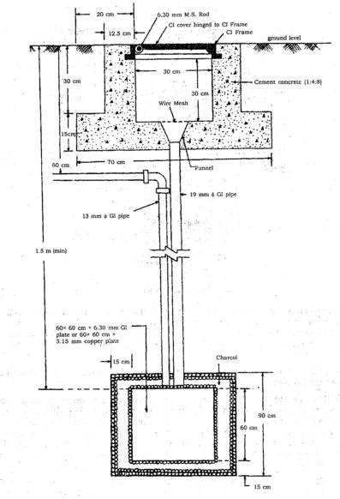
Plate Earthing

Slide 44
Pipe Earthing
Pipe earthing is best form of earthing and it is cheap also.
But the wire is embedded upto the wet soil.
The earth wire are fastened to the top section of the pipe with nut and bolts.
The pit area arround the GI pipe filled with salt and coal mixture for improving the soil conditions and efficiency of the earthing system.
It can take heavy leakage current for the same electrode size in comparison to plate earthing.
The earth wire connection with GI pipes being above the ground level can be checked for carrying out continuity test as and when desired, while in plate earthing it is difficult.
In summmer season to have an effective earthing three or four bucket of water is put through the funnel for better continuity of earthing.

Slide 45
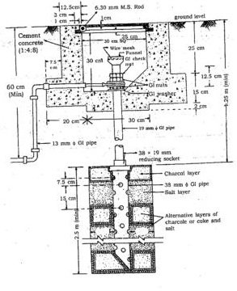
Pipe Earthing

Slide 46
Rod Earthing
In this system of earthing 12.5mm diameter solid rods of copper 16mm diameter solid rod of GI or steel or hollow section of 25mm GI pipe of length not less than 3 meters are driven vertically into the earth.
In order to increase the embeded length of electrod under the ground, which is some time necessary to reduce the earth resistance to desired value more than one rod section are hammered one above the other.
This system of earthing is suitable for area which are sandy in character .
This system of earthing is very cheap

Slide 47
STRIP OR WIRE EARTHING
In this system of earthing strip electrod of cross section not less than 25mm into 1.6mm of copper or 25mm * 4mm of GI or steel are burried in horizontal trenches of minimum depth of 0.5m
If round conductor are used their cross sectional area shall not be smaller than three if copper is used and 6mm2 if GI or steel is used.
The length of burried conductor shall be sufficient to give the required earth resistance (about 0.5Ωto 1.5Ω)
It shall however be not less than 15 m
The electrod shall be as widely distributed as possible in a single straight or circular trenches radiating from a point
This type of earthing is used in rockey soil earth bed because at such places excavation work for plate earthing is difficult

Slide 48
SOURCES OF LIGHT
There are four basic types of lighting:
  Incandescent,
  Fluorescent,
  High-intensity discharge, and
  Low-pressure sodium

Slide 49
Incandescent Light
Light is produced by a tiny coil of tungsten wire that glows when it is heated by an electrical current.
  Shortest lives
  Inefficient

Slide 50
Fluorescent Bulbs
Filled with an argon or argon-krypton gas and a small amount of mercury
Coated on the inside with phosphors
Equipped with an electrode at both ends 3 to 4 times as efficient as incandescent lighting
Fluorescent lamps provide light by the following process:
  An electric discharge (current) is maintained between the electrodes through the mercury vapor and inert gas.
  This current excites the mercury atoms, causing them to emit non-visible ultraviolet (UV) radiation.
  This UV radiation is converted into visible light by the phosphors lining the tube

Slide 51
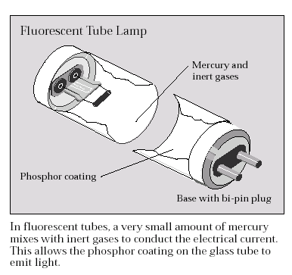
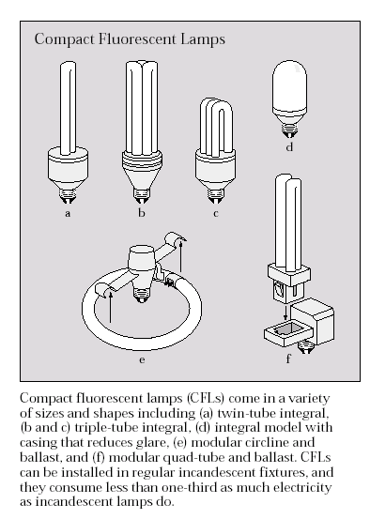
Types of Fluorescent Lamps

Slide 52
Compact Flourescent Lamps
CFLs can replace incandescents that are roughly 3 to 4 times their wattage
They last 10 to 15 times as long.
Cost from 10 to 20 times more than comparable incandescent bulbs
One of the best energy efficiency investments available.

Slide 53
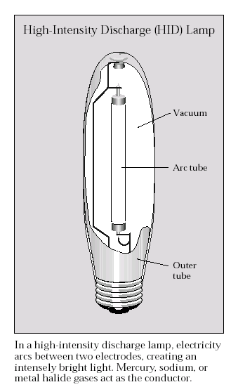
High Intensity Discharge (HID) Lamp
High-intensity discharge (HID) lamps provide the highest efficacy and longest service life of any lighting type
  mercury vapor
  metal halide, and high-pressure sodium
They also require ballasts, and they take a few seconds to produce light when first turned on because the ballast needs time to establish the electric arc

Slide 54
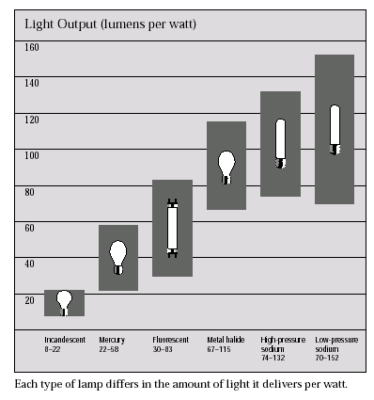
Efficacy
This is the ratio of light output from a lamp to the electric power it consumes and is measured in lumens per watt (LPW).

Slide 55
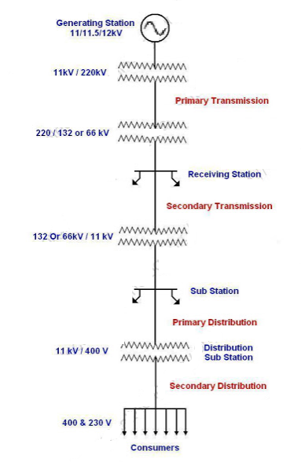
Power Transmission Scheme

Slide 56
ELECTRICAL INJURIES
There are four main types of electrical injuries:
Electrocution (death due to electrical shock)
Electrical Shock
Burns
Falls

Slide 57
ELECTRIC SHOCK
Received when current passes through the body.
Severity of the shock depends on:
Path of current through the body
Amount of current flowing through the body
Length of time the body is in the circuit
LOW VOLTAGE DOES NOT MEAN LOW HAZARD!

Slide 58
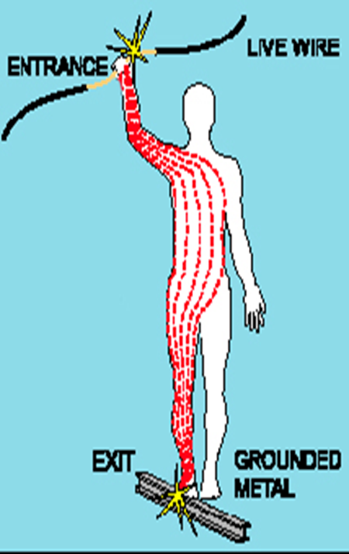
ELECTRIC SHOCK
Electric shock passing through a human body

Slide 59
ELECTRICAL BURNS
Are the most common shock-related nonfatal injury
Occur when you touch electrical wiring or equipment that is improperly used or maintained
Typically occurs on the hands
Very serious injury that needs immediate attention

Slide 60
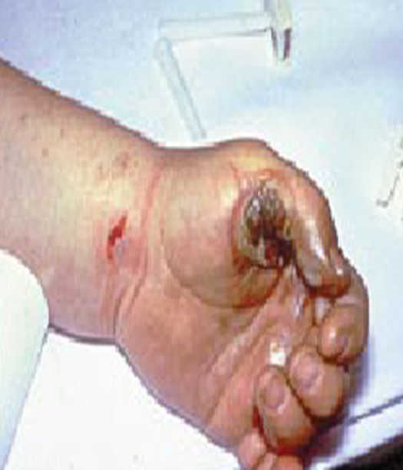
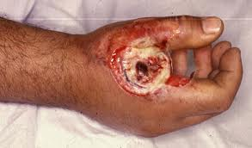
ELECTRICAL BURNS
Electrical burns in hand

Slide 61
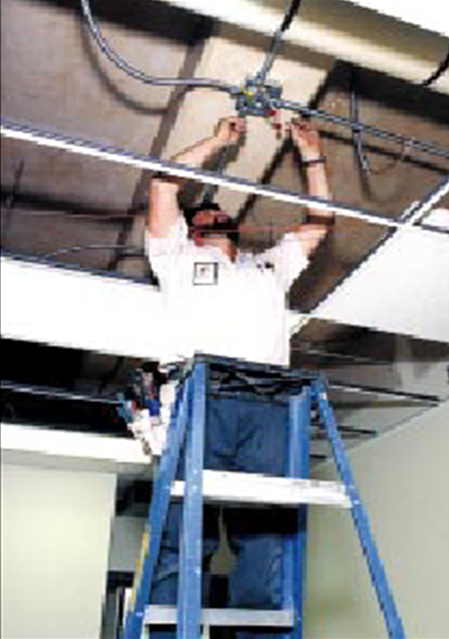
FALLS
Electrical shock can also cause
indirect or secondary injuries.
Employees working in an
elevated location who
experience a shock can fall,
resulting in serious injury
or even death.

Slide 62
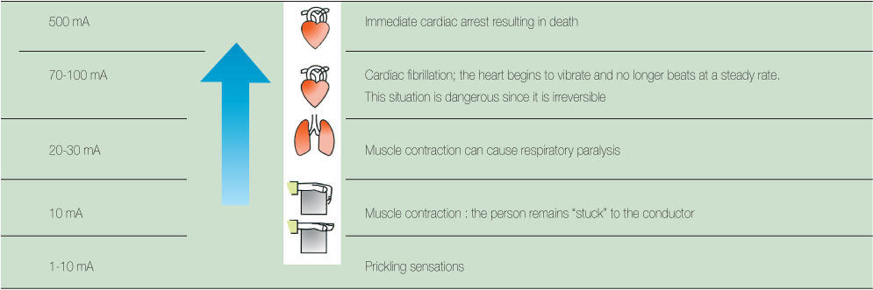
LEVELS OF EFFECT OF CURRENT

Slide 63
SAFE WORK PRACTICES
No metal ladders for or near electrical work.
No wet hands when plugging or unplugging cords/equipment.
No raising or lowering tools by the cord.
Unless equipment is designed for it, cannot be used in damp and wet locations.

Slide 64
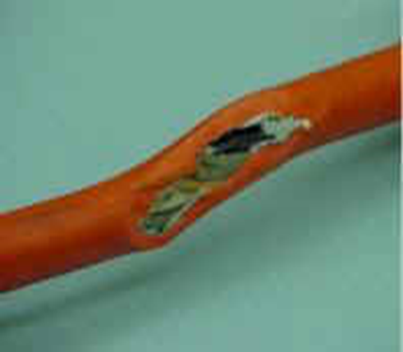
ELECTRICAL SAFETY
If wires are exposed, they may cause a shock to a worker comes into contact with them.
Short circuits are usually caused by bare wires touching due to breakdown of insulation.
Electrical tape or any other kind of tape is not adequate!
Cords in areas of water or
other conductive liquid
must be approved for
those locations.

Slide 65
ELECTRIC SAFETY TIPS
Electrical installations should be inspected, tested and maintained regularly to ensure safety.
Don't try to repair or install electrical wirings or appliances yourself unless you are a registered electrical worker.
Don't use adaptors, plugs or extension units that do not comply with regulations.
Avoid poor contacts when using plugs, adaptors or extension units and watch out for signs of overheating.
Don't overload adaptors and socket outlets.

Slide 66
ELECTRIC SHOCK FIRST AID
Look first. Don't touch. The person may still be in contact with the electrical source. Touching the person may pass the current through you.
Turn off the source of electricity, if possible. If not, move the source away from you and the person, using a dry, nonconducting object made of cardboard, plastic or wood.
Check for signs of circulation (breathing, coughing or movement). If absent, begin cardio pulmonary resuscitation (CPR) immediately.

Slide 67
