Slide 1
PROTECTIVE DEVICES(FUSE,MCB,MCCB,ELCB)

Slide 2
OUTLINE
Introduction.
Fuse.
Types of fuses.
High Rupturing Capacity (HRC) Fuses.
Advantages of HRC Fuses.
Circuit Breakers.
Types of circuit breakers.
Operation of MCB and MCCB.
Time-current characteristics.
Comparison of MCB and MCCB.
Earth leakage circuit breaker.
Conclusion.
References.

Slide 3
Introduction
Over currents:
Overload:
    An overload current is where too much current is drawn down an electrically healthy circuit e.g. too many appliances are plugged in; there is no fault in the circuit. A properly designed circuit will interrupt an overload before any damage is done to the circuit.
Short Circuits:
    This is where a fault of negligible impedance (resistance) occurs between live conductors. The value of current, which will flow, will depend on where the fault occurs. Longer runs of cable, particularly smaller cables have a significant attenuating effect on fault current.

Slide 4
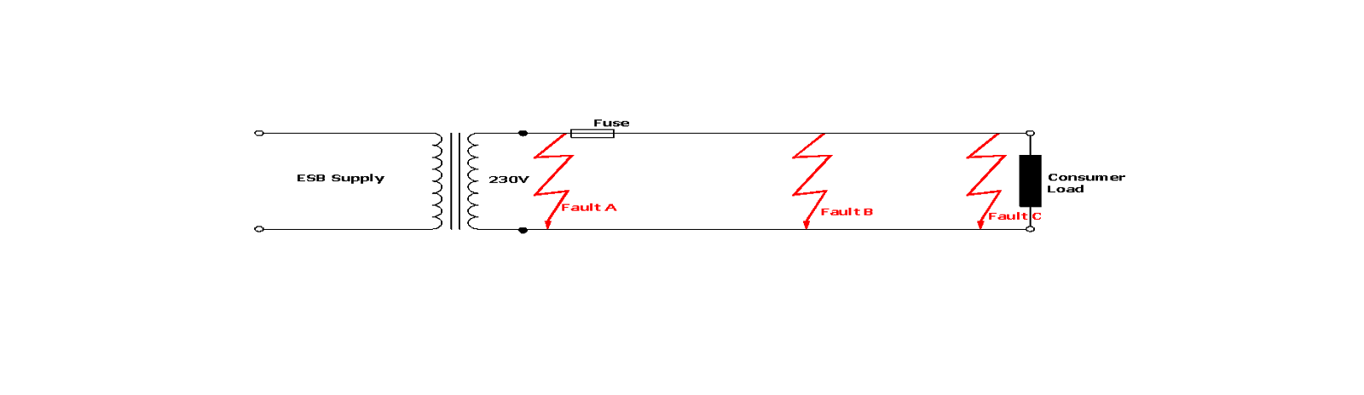
Overcurrents
The fault level, sometimes known as the prospective short circuit (I_{k}) is a significant factor when selecting protective devices – particularly circuit breakers

Slide 5
Overcurrents
Breaking Capacity :
  The purpose of determining the short circuit current at a point in an installation is to determine the Breaking Capacity in kA of the protective device situated at that point
Energy let through in the event of a short circuit is described in terms of:
  Pre-arcing Energy:
    Energy required to melt the fuse element
  Arcing Energy
    Energy required (post pre-arcing energy) to extinguish the resulting arc

Slide 6
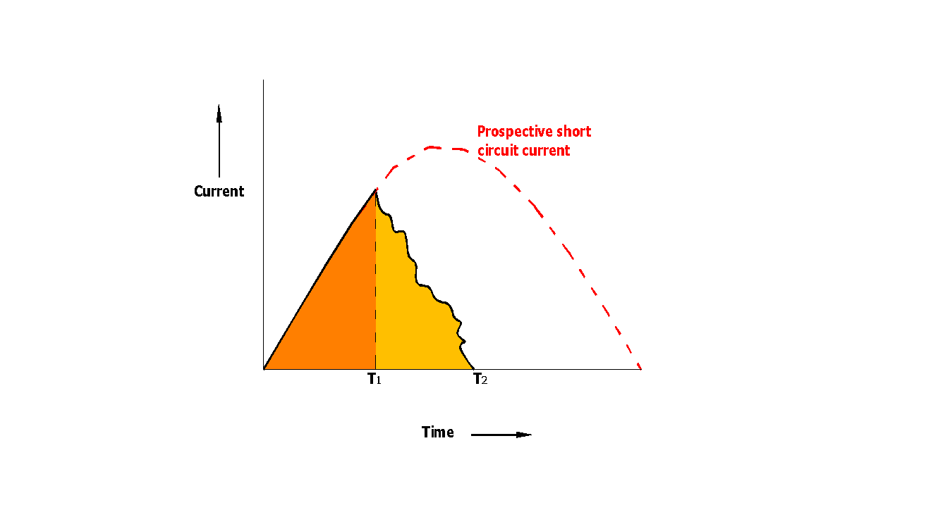
Overcurrents
The total let through energy is proportional to the energy dissipation during the pre-arcing and arcing intervals and is referred to as the I²t characteristic of the fuse/protective device.

Slide 7
Fuse
Over current protection device
A thin strip of wire having low melting point
When excess current flows, the fuse gets heated, melts & breaks the circuit
Fuse element – silver, tin, lead, copper, zinc, aluminum
For current < 10A – alloy of lead & tin
current > 10A – copper wire
Fuse Unit consists of
  Metal fuse element or link
  Set of contacts between which it is fixed
  Insulating body to support & isolate them

Slide 8
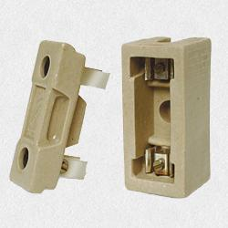
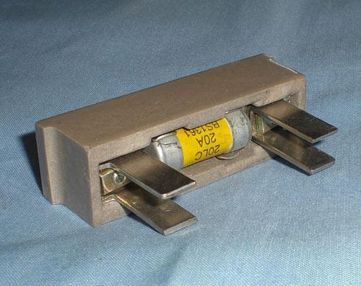
Types of fuses
Rewirable or Kit kat type fuse
  porcelain base with fixed contacts
  Porcelain fuse carrier with fuse element
Catridge type fuse
  - Consists of an insulating container of tube shape
  sealed at its ends with metallic cap called catridge
  Container holds the fuse element and is filled with
  a granular material called filler
  Under abnormal conditions, the fusegets heated
  to high temperature causing it to vapourise

Slide 9
TYPES OF FUSES
  VDE 0635 DZ type fuse:
    This is a cartridge type fuse available in four body sizes D1, D11, D111 and DIV
    Current ratings from 2 Amps up to 100 Amps.
    The D1 size is no longer acceptable in this country but may still be found in very old installations.
    Breaking capacity up to 60kA.
  VDE 0636 NEOZED or DO type fuse:
    This is also a cartridge type fuse available in three body sizes D01, D02 and D03
    Current ratings from 2 up to 100Amps.
    Breaking capacity up to 50kA.
  VDE 0636 NH type fuse:
    Breaking capacity of 120kA.
    They are not designed for replacement by unqualified personnel
    They are available in ratings up to 1250Amps.
  BS 1361 fuse:
    This is a cartridge fuse available in ratings from 5 to 60 Amps.
    They are most commonly used in domestic and similar installations and in supply authority cut-outs.
    They have a breaking capacity of r16.5kA which is adequate for most domestic installation.

Slide 10
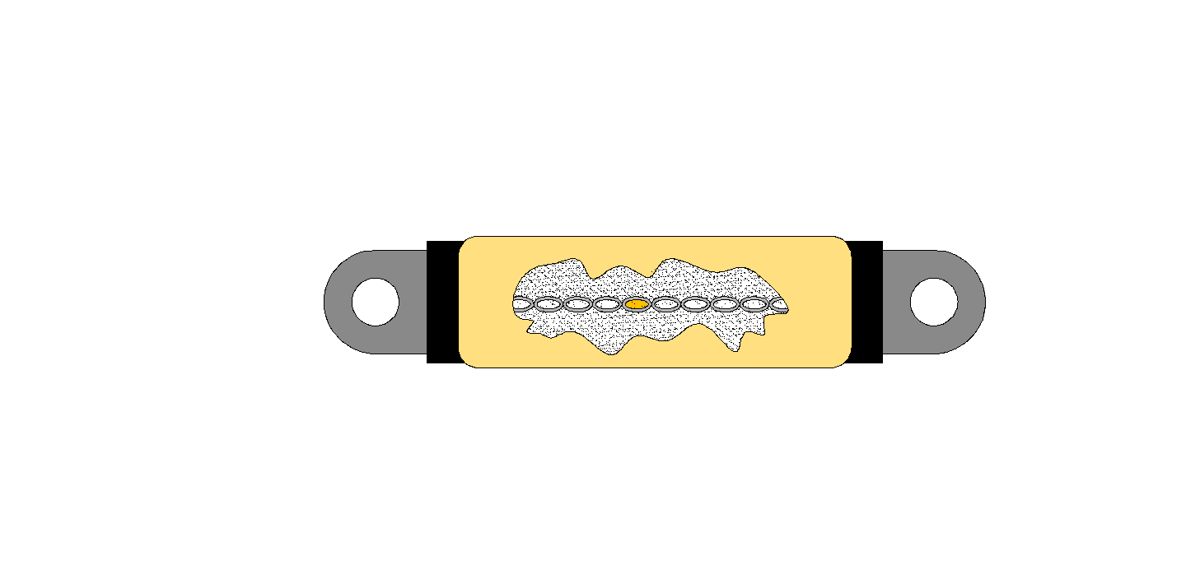
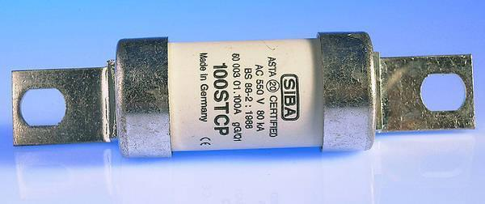
High Rupturing Capacity (HRC) Fuses
The BS88 HRC fuse consists of a specially shaped silver element totally enclosed in a heat proof body which is filled with very fine grains of quartz. The quartz holds the element in place - even while melting - ensures rapid arc extinction. The element is connected to two tinned brass end caps incorporating fixing lugs as shown below.
End cap
Reduced cross sections
Silver Element
Ceramic Body
Overload zone in the element – precise amount of metal with a low boiling point (usually tin). Here the metallurgical phenomenon known as the M-effect is utilised
Quartz filler
Fixing Lug

Slide 11
Advantages of HRC Fuses
  Operation is very rapid
  Capable of breaking very high fault currents safely
  Declared current rating is very accurate
  Element does not weaken with age
  Capable of discriminating between a persistent fault and a transient fault such as the starting of a large inductive motor
  to interchange Different ratings are made to different physical sizes hence they are difficult

Slide 12
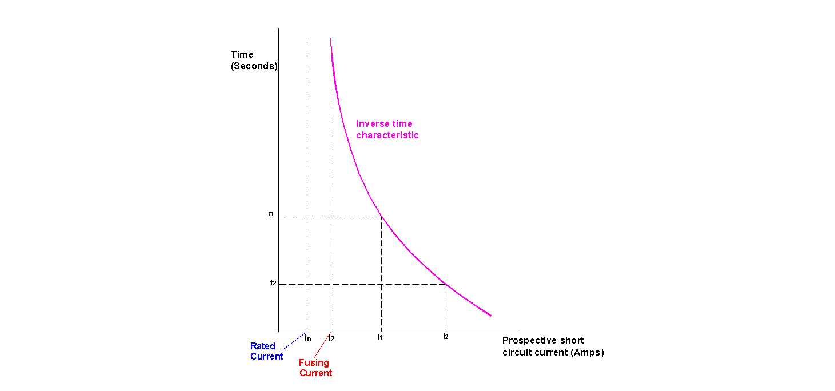
Fuse Characteristics
For a fuse to satisfactorily protect a cable, its characteristic must match, as closely as possible, the heating characteristic of the cable.
This means that fuses have an inverse time characteristic, i.e. the larger the over current, the faster the blowing time of the fuse.
Fuse characteristics are drawn on log/log scale as this enables a wide range of currents along with a wide range of time intervals to be charted

Slide 13
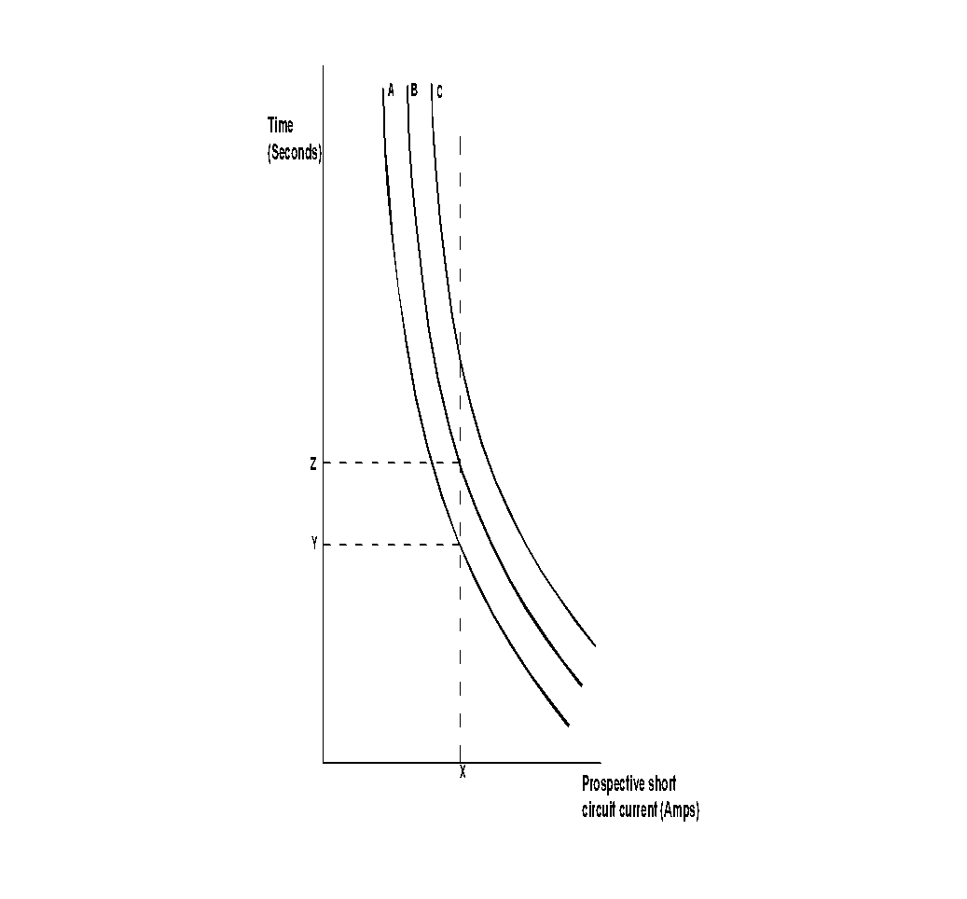
Fuse Characteristics: Discrimination
Discrimination:
  In a correctly designed installation, in the event of a fault, the fuse nearest to the fault should interrupt the circuit before any other device has a chance of interrupting it. This is known as discrimination.

Slide 14
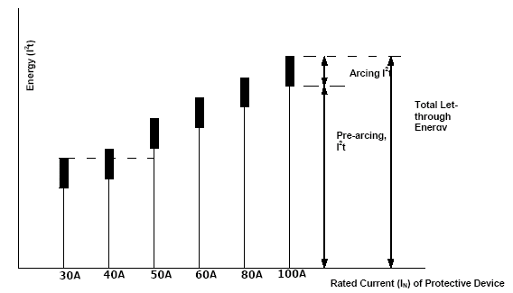
Fuse Characteristics: Discrimination
As Fuse characteristics will have tolerances associated with their manufacture, it is not possible to rely on Inverse time/current characteristics to design for discrimination.
It is necessary to use I²t characteristics

Slide 15
Circuit Breakers
Circuit breakers are divided into three main types :
    Miniature Circuit Breakers (MCB’s)
    Moulded Case Circuit Breakers (MCCB’s)
    Air Circuit Breakers (ACB’s)
From Supply Transformer to Final Circuits, i.e. decreasing breaking capacity

Slide 16
TYPES OF CIRCUIT BREAKERS
Low voltage circuit breakers (upto 1KV)
      MCB (Miniature Circuit Breaker)
      MCCB (Moulded Case Circuit Breaker)
Medium-voltage circuit breakers (1 to 72 kV)
High Voltage Circuit Breakers
      Bulk oil
      Minimum oil
      Air blast
      SF6
      Vacuum CB

Slide 17
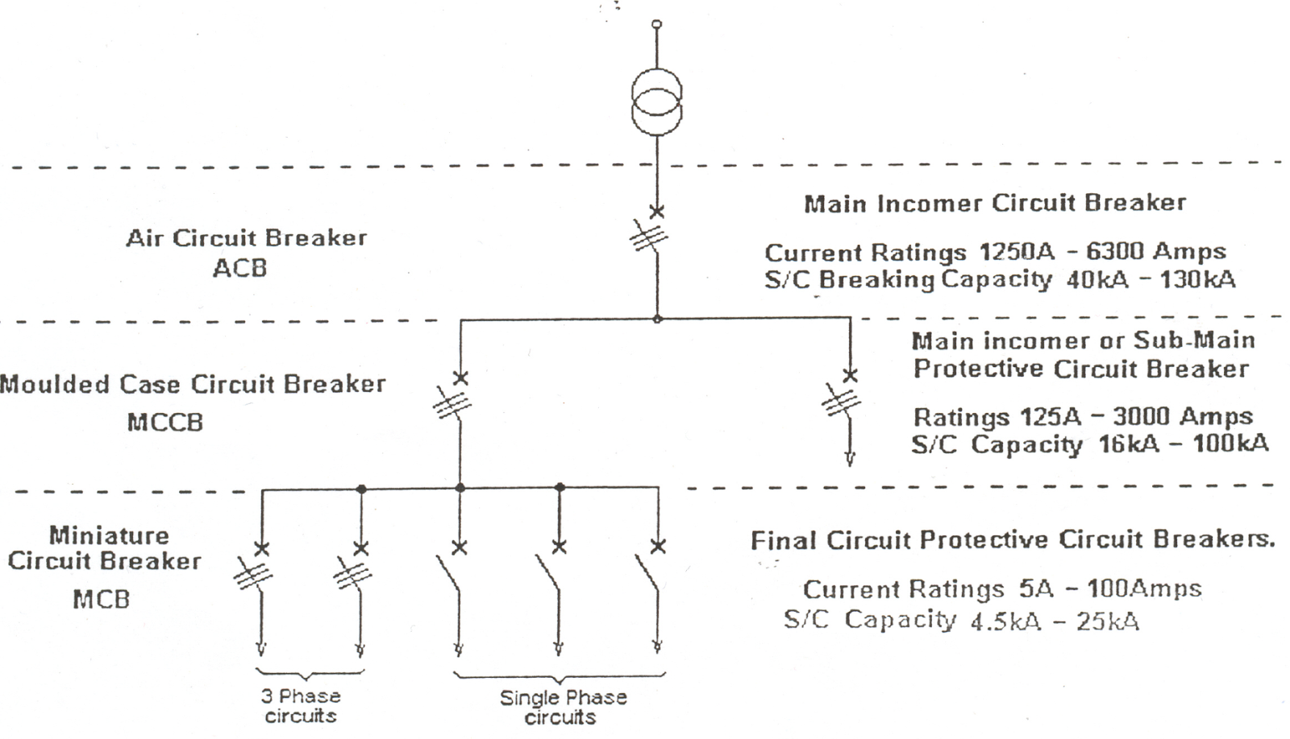
Circuit Breakers
Single line diagram illustrating the sequence in which CBs are employed

Slide 18
OPERATION OF MCB AND MCCB
Provides-
    Overload protection
    Short Circuit protection
    Switching function

Slide 19
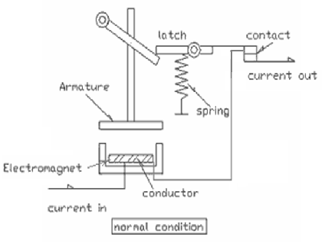
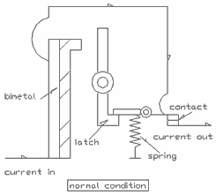
THERMAL TYPE
MAGNETIC TYPE

Slide 20
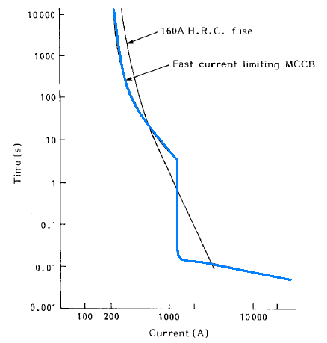
Time/current characteristics of an HRC fuse and MCCB

Slide 21
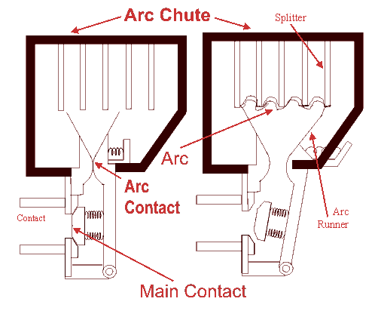
ARC CHUTE

Slide 22
ARC EXTINCTION
Air alone is used alone to extinguish the arc.
Arc Splitting plates - arc resistant ceramic material
Magnetic blowout coils deflect the arc into the arc chute.
Contact opening times ~ 0.5 ms
Total fault clearance time ~ 8 ms

Slide 23
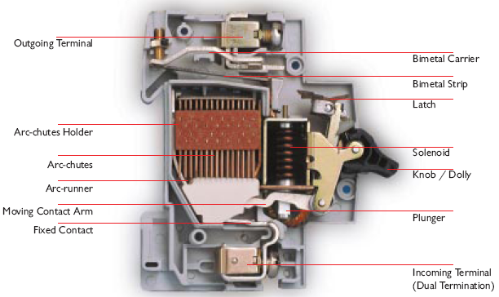
INTERNAL VIEW

Slide 24
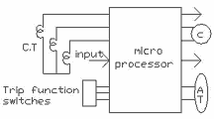
SOLID STATE TRIP (OR)ELECTRONIC TRIP

Slide 25
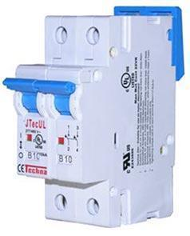
CHOOSING AN MCB
Standard to which the MCB conforms.
      International Standards such as IEC 947, IEC 60898-1
Current rating - maximum current that it will carry continuously without tripping.
Trip characteristic
Type B - 3 and 5 time full load current
Type C - 5 and 10 times full load current
Type D - 10 and 20 times full load current
Breaking capacity.

Slide 26
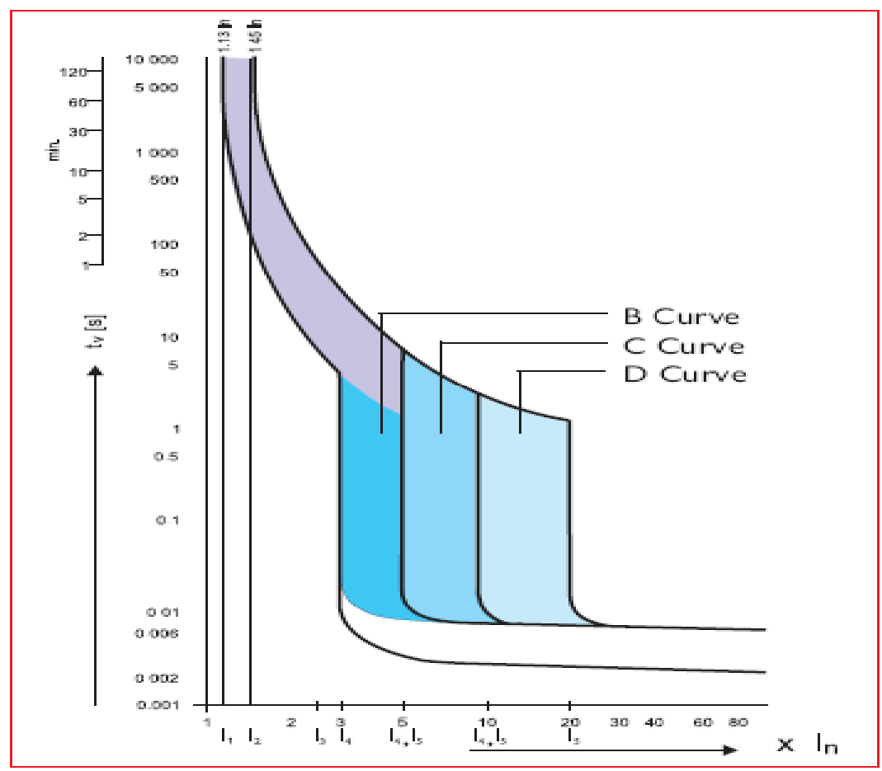
Time/current characteristics

Slide 27
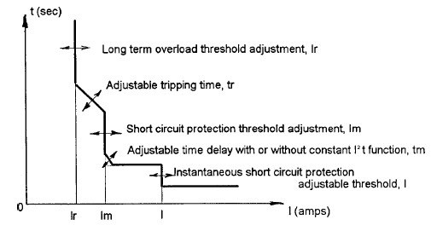
Modern MCCB with Adjustable Characteristics

Slide 28
MCB AND MCCB COMPARISON
MCCB current ratings > 100A - 2.5 kA
MCB – 6, 10, 13, 16, 20, 25, 32, 40, 50, 63, 80 and 100 A
The overall operating time may be adjustable in MCCB
MCCB - positioned close to the power source than the MCBs.

Slide 29
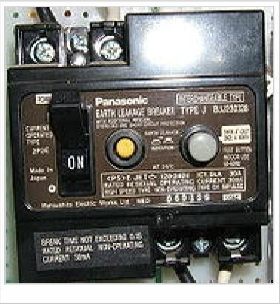
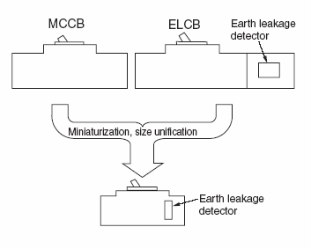
Earth leakage circuit breaker
An Earth Leakage Circuit Breaker (ELCB) is a safety device used
in electrical installations with high earth impedance to prevent shock.

Slide 30
purpose
Many electrical installations have a relatively high earth impedance. This may be due to the use of a local earth rod (TT systems), or to dry local ground conditions.
These installations are dangerous and a safety risk if a live to earth fault current flows. Because earth impedance is high:
1. not enough current exists to trip a fuse or circuit breaker, so the condition persists uncleared indefinitely
2. the high impedance earth cannot keep the voltage of all exposed metal to a safe voltage, all such metalwork may rise to close to live conductor voltage.
These dangers can be drastically reduced by the use of an ELCB or Residual-current device (RCD).
Current-operated ELCBs are generally known today as RCDs (residual current device). These also protect against earth leakage, though the details and method of operation are different.

Slide 31
There are two main reasons why RCD’s are used:
To provide additional and a higher level of protection than that given by direct earthing, against electric shock and also against fire risk caused by earth leakage currents. Where fuses and miniature circuit breakers (MCB’s) are the only means of earth fault protection, it is possible for earth fault currents to flow undetected and cause fire risk (or touch voltage problems).
The use of an RCD will prevent the flow of a sustained leakage current above the sensitivity of the RCD thus greatly reducing shock and fire risk. Red's should disconnect all live conductors in the protected circuits in the event of earth leakage current flowing.

Slide 32
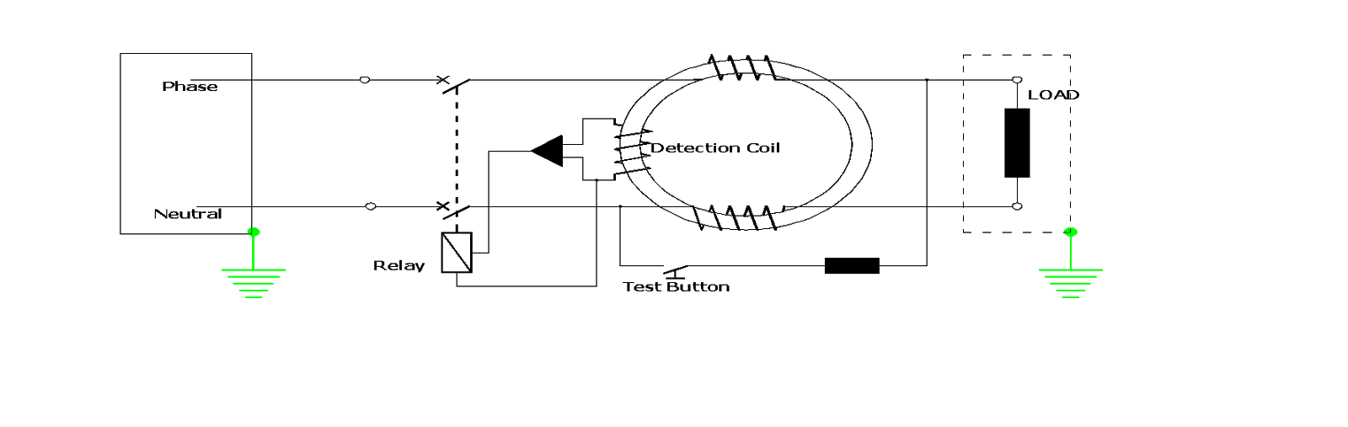
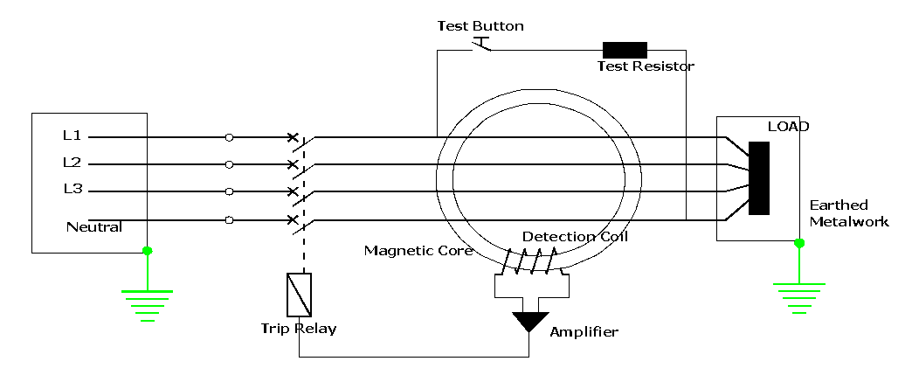
Residual Current Devices (RCD’s
Single Phase RCD
Three Phase RCD

Slide 33
Discrimination between RCD’s:
The time-current characteristic of the device on the supply side shall lie completely above the operating time-current characteristic on the load side
The rated residual operating current of the device located on the supply side shall be higher than that of the device on the load side
Selective operation may also be achieved by means of time-delay devices
Nuisance Tripping:
Sudden surge of over current
Voltage spikes/transients
Inbuilt electronic circuit to protect against such tripping.

Slide 34
CONCLUSION
Domestic and distribution levels - MCB & MCCB preferred over fuse
At higher voltages and high fault currents - fuse remains a highly cost effective solution for protection

Slide 35
REFERENCES
Colin Bayliss & Brian Hardy, “Transmission and Distribution, Electrical Engineering”, Elsevier Ltd.
www.moeller.co.uk/ta_mcb_basics.htm
www.tlc-direct.co.uk/Technical/Distribution/Mcb.htm

