Slide 1
Electrical Safety devices and Safety Measures

Slide 2
Fuse
Overcurrent protection device
A thin strip of wire having low melting point
When excess current flows, the fuse gets heated, melts & breaks the circuit
Fuse element – silver, tin, lead, copper, zinc, aluminium
For current < 10A – alloy of lead & tin
current > 10A – copper wire
Fuse Unit consists of
  Metal fuse element or link
  Set of contacts between which it is fixed
  Insulating body to support & isolate them

Slide 3
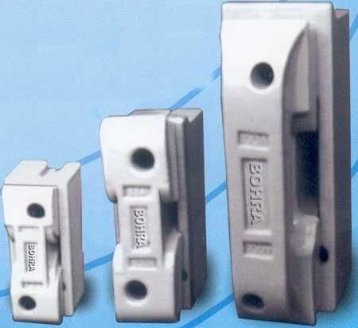


Types of Fuses
Rewirable or Kit kat type fuse
  porcelain base with fixed contacts
  Porcelain fuse carrier with fuse element
Catridge type fuse
  - Consists of an insulating container of tube shape sealed at its ends with metallic cap called catridge
  Container holds the fuse element and is filled with a granular material called filler
  Under abnormal conditions, the fuse gets heated to high temperature causing it to vapourise

Slide 4
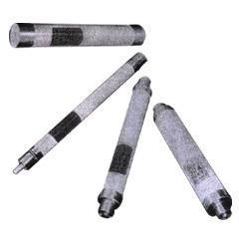
HRC Fuse
  High Rupturing Capacity Fuse
  Used in Medium and High Voltage installations
  Consists of ceramic tube with metal end caps and fixing tags
  Fuse element is a silver strip with low melting point riveted in the center
  It is surrounded by chemically purified silica

Slide 5
Earthing
Connecting an equipment to the earth so as to ensure at all times an immediate & safe discharge of electric energy due to leakage, faults etc
Earth potential is taken as zero for all practical purposes
Necessity of Earthing
  To provide greater safety to personnel & equipment from the danger of current leakage
  To maintain a constant voltage in healthy phases in the event of a fault in one phase
  To serve as a return conductor in communication and traction works

Slide 6
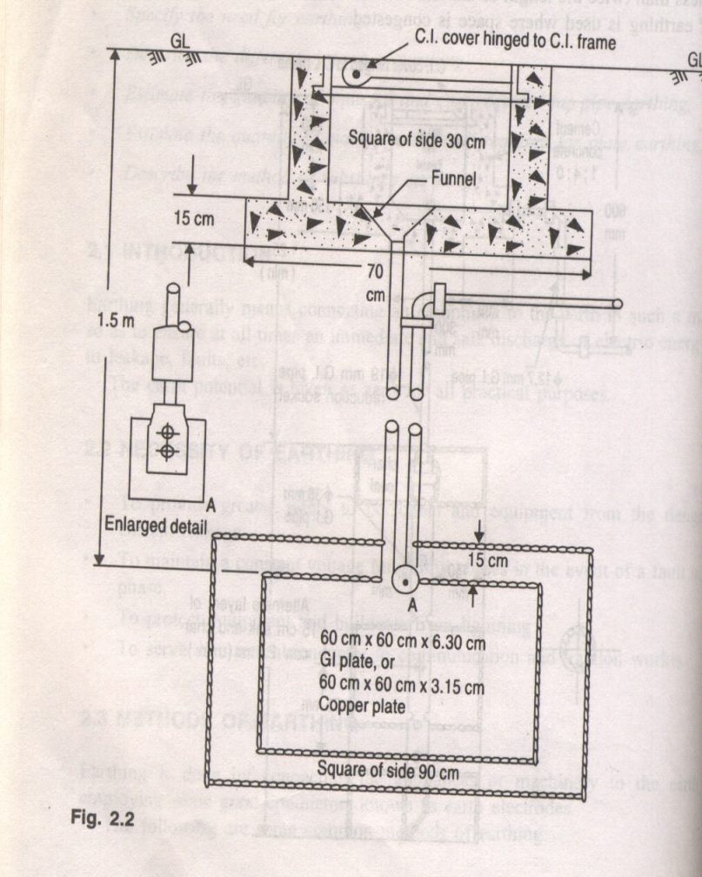
Methods of Earthing
Plate Earthing:
Normal size of the plate –
60cm x 60cm to 120cm x 120cm
Electrode is buried at a depth of at least 1.5m
Plate material Vs minimum thickness
Plate Material | Minimum thickness
Copper | 3.15mm
Galvanized iron | 6.3mm
Cast iron | 12mm

Slide 7
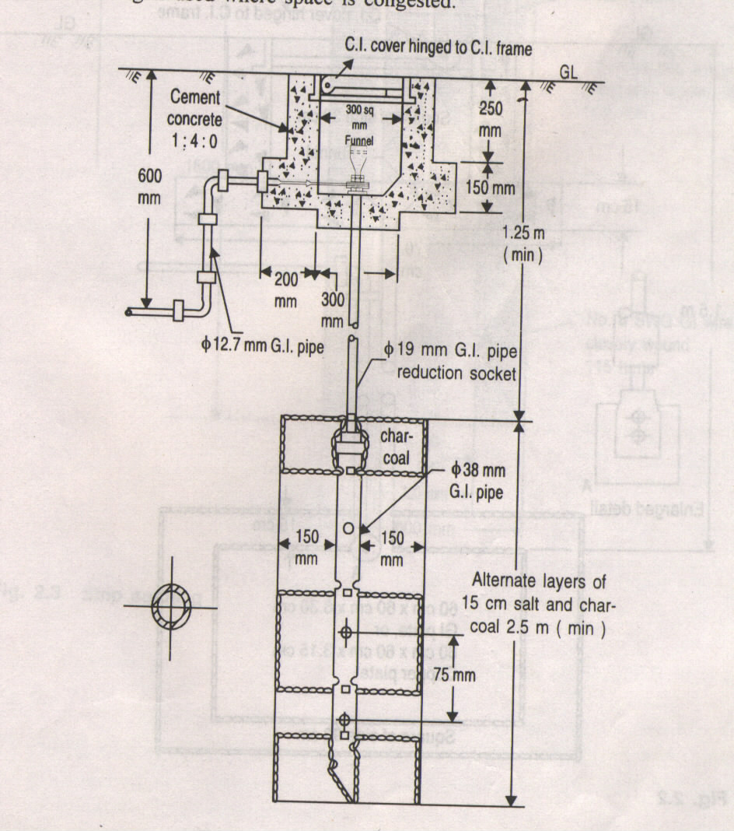
Pipe or Rod Earthing:
Used in congested areas
The normal size of the C.I. Pipe used is 2.5 to 3 meter long, 100 mm diameter and 13mm thickness.
Where rod is used, the length of the rod is between 1.22 to 2.4 pm. And the diameter varies between 13 to 19 mm.
The pipe /rod is driven to a depth of approximately 3m in the ground.

Slide 8
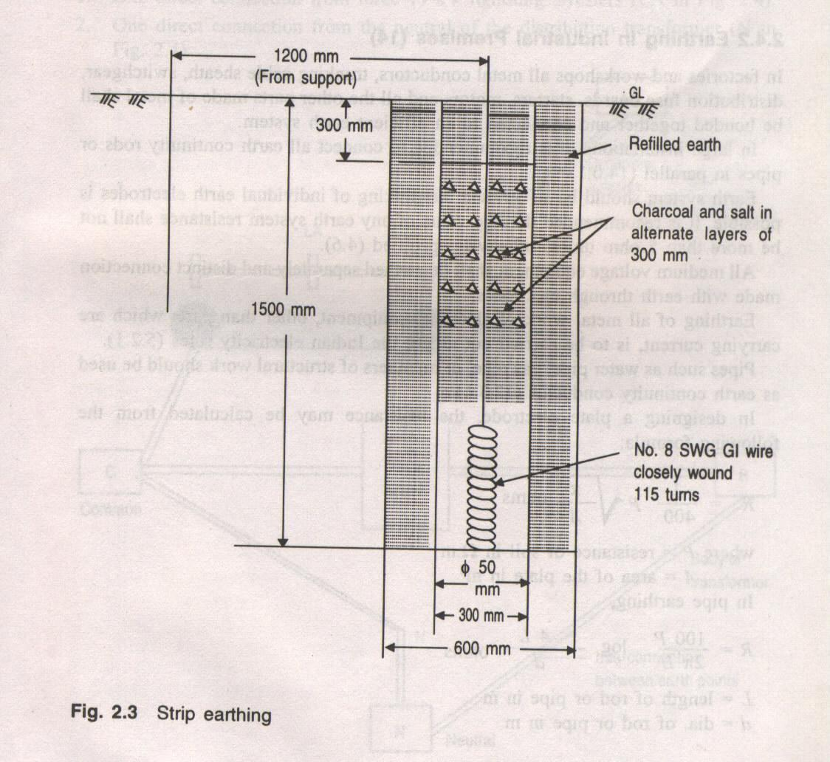
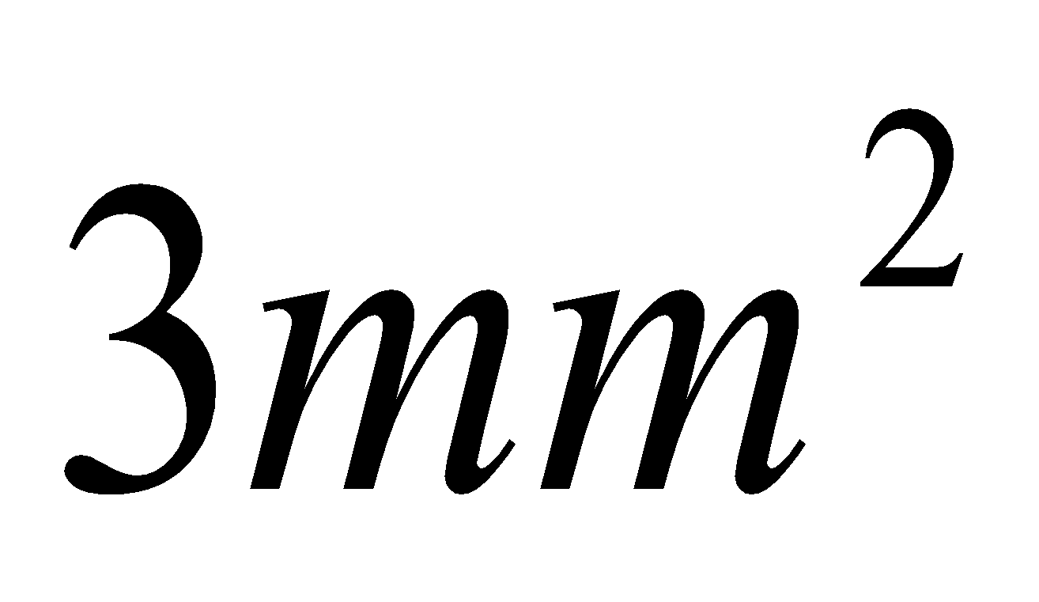
Strip or Conductor Earthing:
Used in places where the topsoil has got lower resistivity but underneath it has very high resistivity like a rock etc.
An approximate length of the stripe is buried in the top soil at a depth of not less than 0.5m to give reasonably low earth resistance.
Copper strip if used shall not be less than 25mmx1.6mm in cross section.
Copper conductor shall not be less than

Slide 9
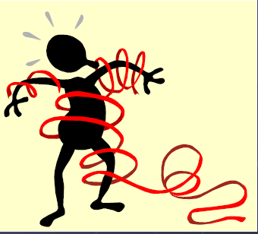
Hazards of Electricity
Primary hazards – Electrocution (Electric shock)
- Fire and explosion
Secondary hazards – Burns
Effect of shock depends on
  Magnitude of the current
    Voltage
    Body Resistance
  Current path through the body to the earth
  Duration of contact

Slide 10
Effect of electric shock
Current Value | Effects
1mA | No Perception
1 – 5 mA | Sensation of shock, Not painful, individual can still let go
5 – 15mA | Painful shock, Reflex action, individual can still let go
15 – 20mA | Painful shock, Muscular control is lost in the current path, cannot let go
20 – 50mA | Painful muscular contraction leading to light /severe cramp, breathing difficult
50 – 100mA | Paralysis/suffocation
100 – 200mA | Can bear for a very short time. Ventricular fibrillation possible
200 – 500mA | Cardiac arrest possible. Even deaths are encountered
>500mA | Fatal by longer contact Death with internal burns.

Slide 11
Preventing Electrical Hazards
Electrical accidents appear to be caused by a combination of three possible factors:
  unsafe equipment and/or installation,
  workplaces made unsafe by the environment,
  unsafe work practices.

Slide 12
Precautions to be taken against Electric shock
Avoid working on live electrical parts
Wear proper insulating boots and gloves as necessary
Follow Lock-out tag-out procedures as required
When working on high voltage, make sure that the floor is not made of any conducting material
Make sure that no part of your body comes in contact with earth, metallic casing, metal plates or cross arms when working on high voltage
Avoid working at places where your head is liable to touch the live parts or mains
Never touch an energized person with your bare hands but rather use a wooden broom or other non-conductor to push them away from the source of current

Slide 13
General Safety Instructions
Only authorized, competent, and qualified persons are allowed to work on or around electrical equipment and/ or wiring.
The person in-charge shall explain the precautions to be taken by the workman before issuing the permit.
Purchase up-to-standard electrical equipment equipped with appropriate protective devices
Proper maintenance of system and equipment
Exercise care: Place yourself in a safe and secure position to avoid slipping or stumbling. Make a habit of being cautious.
Think carefully before you act. Make sure you are right.
Treat everything as live unless it is positively known to be dead and properly earthed. All voltages are dangerous. Even low voltage shocks may be fatal.
Extra precautions should be taken when working in abnormally damp areas.
Follow the DO’s and DON’Ts instructions. These should be displayed in all establishments at places of convenience and personnel trained repeatedly.

