Slide 1
Workshop Practice 1
Electrical Workshop
Tools
Accessories
Wiring Methods

Slide 2
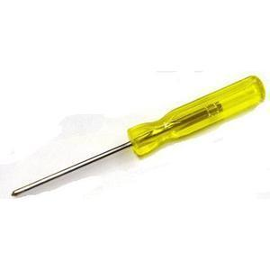
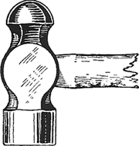
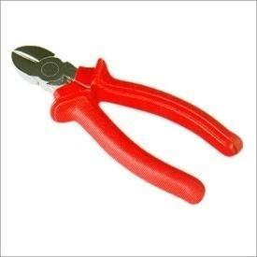
Tools
Screw Driver
used for tightening or loosening the screw
three parts; handle, blade and working edge
working edge is tempered
size is specified based on its blade length (in mm/inch) – 2” to 12”
2) Ball Peen Hammer
size of the hammer is indicated by its weight (0.12kg, 0.25kg, 0.50kg, 0.75kg, 1kg etc.)
ball peen hammer is mainly used in electrical trades
three parts: wooden handle, face and ball
3) Side Cutting Plier
size is given according to its length (in mm/inch) – 150mm, 200mm etc.
has a cutter on its side
used for cutting wires and nipping the insulation from the wire

Slide 3
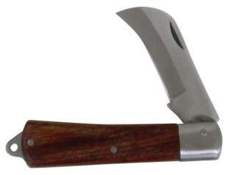
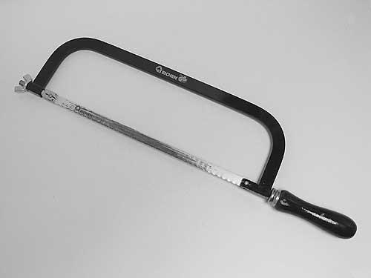
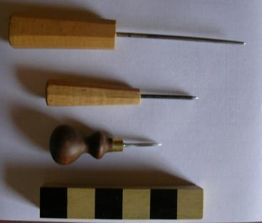
4) Electrician’s Knife
used for removing the insulation from the wire
size is measured by the length of the cutting blade (50mm)
5) Hack Saw
used for cutting conduit pipes, GI pipes, and small pieces of iron
two types → fixed and adjustable
in adjustable hack saw, different length of blades can be used
main parts → frame, blade, handle and fly nut
size is indicated by the length of the blade (200mm, 250mm, 300mm)
6) Bradawl Square Pointed Pocker
two main parts→ wooden handle and pointed square blade
size is indicated by mentioning the size of the blade
used for making pilot holes in wood before fixing and tightening of
screws

Slide 4
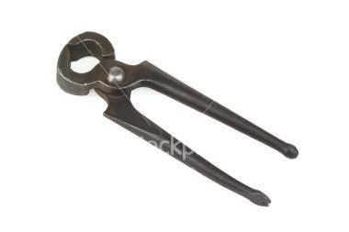
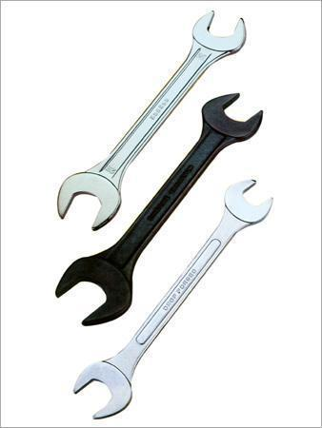
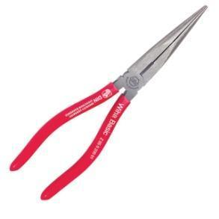
7) Pincer
used for removing nails from the wood
two parts→ jaw and leg
size is measured by the overall length (100mm, 150mm, 200mm etc)
8) Spanner Set
used for loosening and tightening nuts and bolts
made of cast steel
size is indicated so as to fit on the nuts (10-11 mm, 12-13 mm, 20-22mm)
adjustable spanner is also available
9) Nose Plier
used for holding work
two types → flat and round
flat is used for holding flat objects like hexagonal nuts etc.
round is used for making hooks and loops of thin wires
size depends upon the length (100mm, 150mm, 200mm)

Slide 5
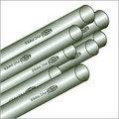
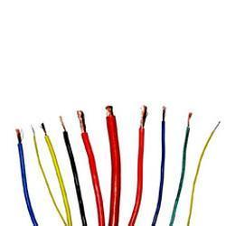
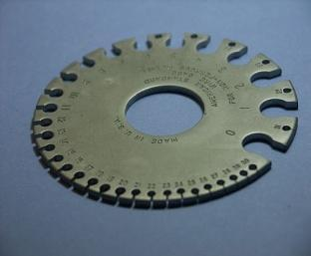
Wiring Accessories
1) Conduit
used for making electrical piping system to protect and route the wiring
made up of plastic, metal, fibre etc.
size is measured by the diameter in inch (1/2” through 6”)
2) Wiring Cable
PVC insulated copper wires are used for household applications
size is mentioned by no. of strands in one wire and dimension of one strand (14/0.3mm, 7/2.14mm etc.)
current carrying capacity of a conductor depends on cross sectional area
3) Standard Wire Gauge
the diameter of the strand can be found from this
consists of Standard Wire Gauge numbers and each number represents a particular strand diameter (12 → 2.61mm)

Slide 6

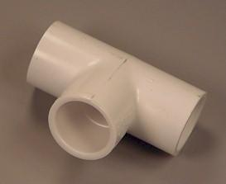
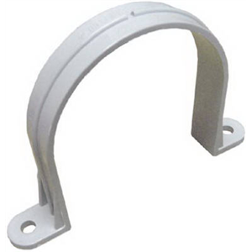
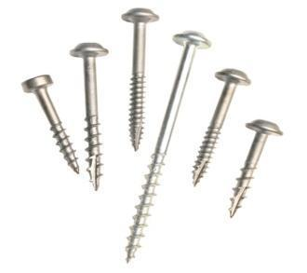
4) PVC Elbow
used to take the wiring through a curved path
size is mentioned same as that of conduits
size of the conduit and joint should match
5) PVC Tee Joint
used to take the wiring towards different directions
towards the switch and appliance
size is mentioned same as that of conduits
size of the conduit and joint should match
6) PVC Clamp
used for fixing the conduit on the building surface
screws are used to fix clamp on the surface
size is mentioned same as that of conduits
size of the conduit and joint should match
7) Screws
two parts → head and body
size is mentioned by the length of the body (15mm, 30mm, 35mm etc.)
used for fixing the clamps, ceiling roses etc.

Slide 7
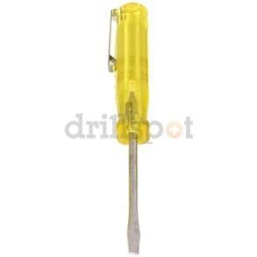
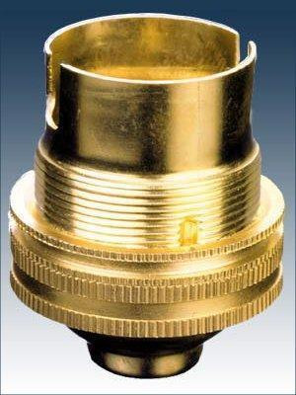
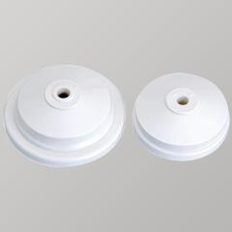
8) Tester
used for checking any electrical part is live or not
light indication is provided
keep it on the electrical part and keep our finger on the back side metal part
if it’s live, the light will glow
9) Pendant Lamp Holder
used for holding the lamp required for lighting purposes
has porcelain interior with a solid or spring plunger and easily wired terminals plunger
lamp shade can be fixed to the lamp holder
10) Ceiling Rose
situated at the termination of the fixed wiring
consists of brass terminals mounted on or in an insulating base, provided with an insulated cover and incorporating a grip for flexible cord
can be arranged for mounting direct on building surfaces
size is mentioned in electrical terms (by specifying the current and voltage ratings (250 V, 5 A))

Slide 8
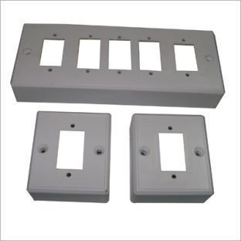
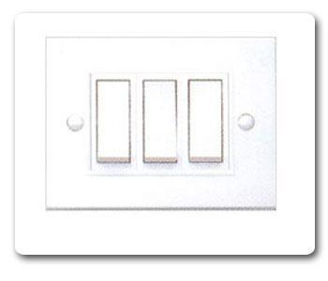
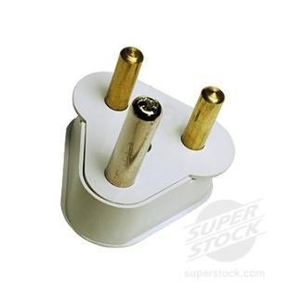
11) Gang Box
used for holding the switches at particular position
multiple gang boxes are used to install several wiring installations in a single location
dimension depends on no. of switches and plugs
rating is specified in voltage (250v)
12) Switch
used for opening or closing a circuit or part of a circuit
conducting portions are terminals and contact surfaces which are mounted on insulating material.
SPST- one way switch has two terminals whereas SPST-two way switch has three terminals
ratings depends upon the voltage and current ratings; and also type of wiring
13) Plug
device installed on the portable cord to enable connection between the cord and receptacle(socket) for getting the power supply
two type configuration → with or without Earth pin
Earth pin will be larger than the other two in order to ensure proper Earthing before the other two touches the live part
ratings depends upon the voltage and current ratings
Notes:
*

Slide 9
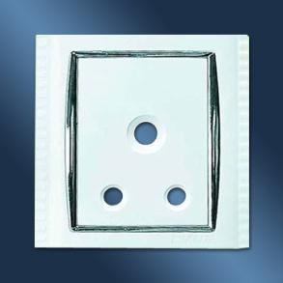
14) Receptacle (Socket)
equipped with no. of slots , namely, Earth, Phase and Neutral
configuration depends on the no. of phases used, the available voltage and the amperage

Slide 10
Wiring Methods
Following factors influence the wiring method
Durability
Safety
Appearance
Cost
Accessibility
Maintenance Cost

Slide 11
Wiring methods are classified as
Cleat Wiring
Casing & Capping
T R S Wiring
Metal Sheathed Wiring
Conduit Wiring

Slide 12
Cleat Wiring
conductors are supported in porcelain cleats
cleats are made in two halves, one is fixed to the wall and other is screwed to the first by keeping the conductor inside the groove
cleats will be having more than one groove
cheapest methods of wiring
wires are exposed to view → cannot be used in industries
suitable for temporary wiring
cleats should be used at intervals of 30cm in order to avoid sagging of wires

Slide 13
Casing and Capping
commonly used in residential buildings
consists of rectangular blocks, called casing and rectangular strip called capping
made up of wood or Plastic
casing will have two grooves in which wires are laid, capping is screwed to casing
two or three wires of same polarity may be run in one groove and wires of opposite polarity may not
cost is more if wooden material is used
every risk of fire

Slide 14
Tough Rubber Sheathed (TRS) Wiring
TRS cables are available in single, twin or three core with a circular shape or oval shape
flexible cable which resist moisture, climatic variations, acids etc.
can be run on the surface of the walls or buried in plaster
usually laid over wooden batten which is fixed on the wall
clips are used to fix the cable on the wooden batten
care has to be taken if buried under plaster because nails may touch the wiring
bends should be provided with longer radius to avoid cracks

Slide 15
Metal/Lead Sheathed Wiring
consists of insulated conductor covered with an outer sheath of lead alloy containing about 95% lead which provides a protection to the cable from mechanical injury
can be run on wooden beading or batten in residential buildings
lead sheath must be earthed to avoid lead deterioration due to electrolytic action of leakage current
Earthing provides safety against the metal sheathing becoming alive
costlier than TRS

Slide 16
Conduit Wiring
wires run in metallic or PVC conduits
best system → provides mechanical protection, safety against fire and shock if Earthing is proper
most desirable for all kind of applications
conduits can be either be buried under plaster (recessed conduit wiring) or can be fixed to the wall with clamps (surface conduit wiring)

Slide 17
References:-
Electrical wiring, estimating and costing by S.L.Uppal
Practical wiring (volume 1) by Henry A.Miller
Handbook of electrical construction tools and materials by Gene Whitson

