Slide 1
“AIR POWERED VEHICLES”

Slide 2
CONTENTS
Introduction
Historical Development
Details of Air Car
  Air Tank
  Chassis
  Air Filters
  Engine of Air Car
  Body of Air Car
Principle of Working
Advantages of Air Car
Disadvantages of Air Car
Applications

Slide 3
INTRODUCTION
One of the major problems most developing countries facing today is air pollution and the major source of which is automobiles running on road.
Concerning resource availability there has been a strong warning indicating that petroleum resources may be depleted in the relative near future.
Gasoline which has been the main source of fuel for the history of cars. It produces carbon monoxide, Nitrogen oxides and unburned hydrocarbons which are the main pollutants and are responsible for bad effects of pollution.
There comes need to think about alternatives such as Biodiesel and natural gas, Electric cars, Hybrid cars, Hydrogen fuel cells but, these alternative fuels also have some drawbacks.
One possible alternative fuel is the compressed air.

Slide 4
HISTORICAL DEVELOPMENT
One of the versions of an air-powered car is being developed by Abe Hertzberg.
The Washington researchers use liquid nitrogen as the propellant for their LN2000 prototype air car.
The researchers decided to use nitrogen because nitrogen makes up about 78 percent of the Earth's atmosphere.
The liquid nitrogen, stored at -320 degrees Fahrenheit (-196 degrees Celsius), is vaporized by the heat exchanger.

Slide 5
Contd….
But LN2000 had developed some drawbacks like
Reduces the efficiency of the car.
It consumes about 5gallons of nitrogen fuel per mile also it reaches a top
speed of only 22 mph and fails to accelerate up on the hills.
Also the motor operates at less than 20 percent of efficiency.
Thus LN2000 has failed due to lack of power output, performance and
fuel economy.
With the same basic principle the next version of air car has been
developed by Guy Negre.
His used fuel has the compressed air for operating an engine.

Slide 6
Details of air powered car
1. Air Tanks
2. Chassis
3. Air Filter
4. Electrical
System
5. Engine of the
Car
6. Body

Slide 7
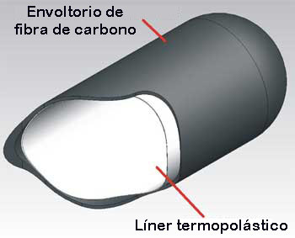
AIR TANKS
Composition of Air Tank:
The air tanks in air powered cars are composed of an interior thermoplastic container which ensures it is airtight.
This is held in a coiled and crossed carbon fibre shell.
This technique is the result of many studies into factors such as: mechanical specifications, density of material, choice of fibres etc.

Slide 8
AIR TANKS (Contd….)
The specifications of tank are,
Maximum effective pressure: (300 bars)
Temperature of use: (–40°C to 60°C)
The tanks weigh 35 - 40 kg for 100 liters of air at 300 bars.
The tanks are submitted to numerous tests to meet official approval such as:
1) Pressure testing
2) Rupture testing
3) Cycles at ambient and extreme temperatures
4) Fire-resistance testing
5) Resistance to cuts
6) Shock and fall testing
7) Airtight testing

Slide 9
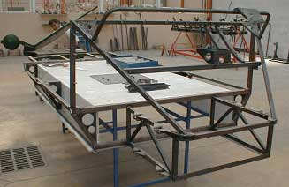
CHASSIS
Based on its experience in aeronautics, MDI has put together highly-resistant, yet light chassis. Aluminium rods glued together. Using rods enables us to build a more shock-resistant chassis than regular chassis. Additionally, the rods are glued in the same way as aircraft, allowing quick assembly and a more secure join than with welding.

Slide 10
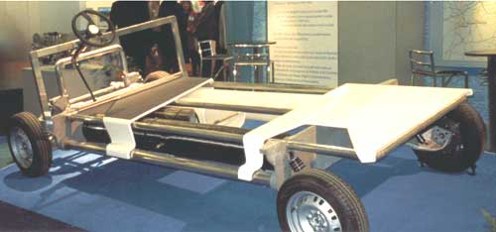
Location of Air tank with a protective plate fixed on chassis

Slide 11
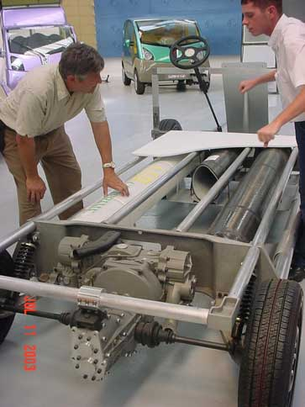
Location of Engine & Air tank on Chassis

Slide 12
AIR FILTERS
The MDI engine works with air that is taken from the atmosphere and air
pre-compressed in tanks.
Air is compressed by the on-board compressor or at service stations
equipped with a high-pressure compressor.
Before compression, the air must be filtered to get rid of any impurities
that could damage the engine.
Carbon filters are used to eliminate dirt, dust, humidity and other
particles which, unfortunately, are found in the air in our cities.

Slide 13
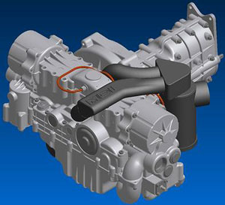
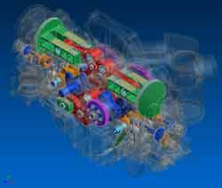
ENGINE OF AIR CAR
Characteristics: Single energy bi-cylindrical 1200cc engine with a pause at the Peak Rest Point for 70°, variable volume expansion chamber, Power limited to 25cv.
Expansion cylinder: 1200cc
Year of invention: 2000/01
Advantage: Impressive torque motor curve.
Disadvantage: The utilization of two connecting crank-shafts for gears caused vibration problems.

Slide 14
BODY OF AIR CAR
The MDI Car Body is built with fibre and injected foam, as are most of the cars on the market today.
This technology has two main advantages:
low cost and reduced weight.

Slide 15
BASIC PRINCIPLE
Air at 100 degree Celsius and 300 bar pressure is used as a fuel.
When this air is allowed to expand at atmospheric conditions its
volume increases and this energy produced is used to
drive pistons of air powered car.

Slide 16
Following table shows comparative study for different features of Air cars with the Electric cars in market today
Comparison Chart | 2000 Nissan Altra EV | 2001 Toyota Rav 4EV | 2001 City C.A.T
Fuel type | Electric | Electric | Compressed Air
MPG Avg. | 123 | 104 | 108
Annual fuel cost | Rs 13275 | Rs 15680 | Rs 8850
Annual green house gas emissions | 3.5 | 4.1 | 1.2
Range | 129 | 126 | 120
Top speed | 75 kmph | 78 kmph | 60 kmph
Engine characteristics | 62kw AC | 50 kw DC | Compressed air
Recharge time | 5 Hrs | 6.75 Hrs | 4 Hrs
Price (MSRP) | Rs 20,45,000 | Rs 16,84,200 | Rs 5,61,400

Slide 17
ADVANTAGES OF AIR CARS
Uses air which is naturally and cheaply available.
Also light in weight (approx 800 kg) due to use of composite material, with attractive looks.
In conjunction with compressed air it also runs on traditional fuel i.e. when car runs below 60 kmph it runs on compressed air and above 60 kmph it runs on traditional fuel like gasoline, diesel, etc which is electronically controlled.
The air powered cars are equipped with a range of modern systems. For example, one mechanism stops the engine when the car is stationary i.e. at traffic lights, junctions etc. Unlike conventional cars, the engine does not operate in traffic jams, which thus saves on fuel.
Another interesting feature is the pneumatic system. When the car brakes, the kinetic energy from braking is used to drive a pump that helps to restore some of the lost pressure.
During refueling the natural air is passed through carbon filter where the impurities of the air are removed and henceforth the air expelled from the car gives negative pollution i.e. it removes pollution from the surrounding air.

Slide 18
DIS-ADVANTAGES OF AIR CARS
The power needed to develop compressed air is electricity, and for generation of electricity fuels are used which creates pollution at power stations.
While operation the engine creates noise due to sudden expansion of air.
Considering power point of view air powered cars are still behind gasoline cars.
But these drawbacks are not much serious and can be removed by,
Using wind, hydraulic systems, fuel cells and photovoltaic to fill up air tanks.
By encasing the engine to reduce noise.
By increasing air carrying capacity we can increase power output of air car.
Thus air cars are the best options suitable to current conditions around us.

Slide 19
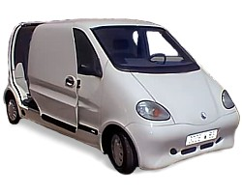
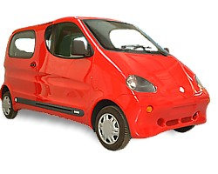
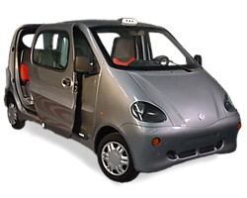
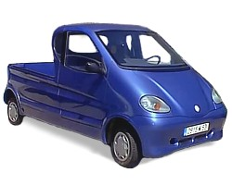
APPLICATIONS
1. Family
Cars
2. Vans
3. Taxis
4. Pick-Ups
5. Mini-Cats

Slide 20
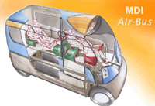
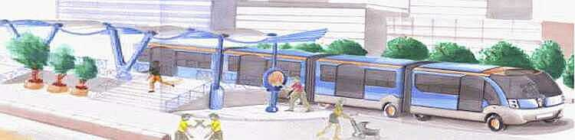
CONCEPT (FUTURE) APPLICATIONS
MDI has developed various
vehicles and systems
which promise to
drastically change the
outlook of public
transportation and energy
use.
A new concept in public
transportation, the
MULTICAT is a train,
consisting of a number of
carriages:
1. The driver’s car
(Locomotive)
2. Passenger carriages (Wagons)

Slide 21
CONCLUSION
The AIR POWERED CARS are the best options which provide most
comprehensive answer to the present urban pollution problems in simple,
economic and inoffensive manner.
These are clean, easy to drive, comparatively low cost and does not take a life time
to pay off.
Thus these vehicles are safe to manufacture, safe to use, safe to users and also
environment friendly.

Slide 22
THANK YOU

