Slide 1
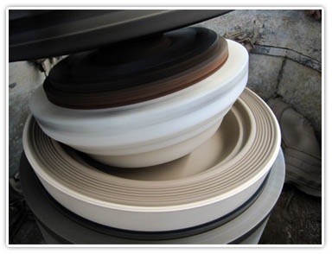
MANUFACTURING PROCESSES
FABRICATION&PROCESSING OF CLAY PODUCTS
ROSHITH KV
S4 ME
R.N 48

Slide 2
CERAMICS
The word ceramics is derived from the Greek word ‘keramos’ which means potter’s earth or clay.
The ceramic may be considered as material made from naturally occurring clay or earth.
In modern applications , a broader definition regards ceramics as everything that is not a metal or organic material .
Ceramics may be classified as natural or manufactured
Natural ceramics
The most frequently used ,naturally occurring ceramics are silica , silicates and clay minerals .
(b) Manufactured ceramics
Such ceramics include sic ,Al2O3 ;Silicon Nitride, and many varieties of oxides ,carbides ,Nitrides, Borides and more complex ceramics

Slide 3
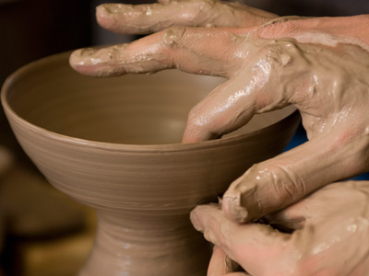
CLAY PRODUCTS
Clay is defined as a natural, earthy, fine-grained material, largely of a group of crystalline
hydrous silicate minerals known as clay minerals
Clay minerals are composed mainly of silica,alumina, and water, but they may also contain
appreciable quantities of iron, alkalies, and alkaline earths.
. Common clay is defined as a plastic clay or claylike material with a vitrification

Slide 4
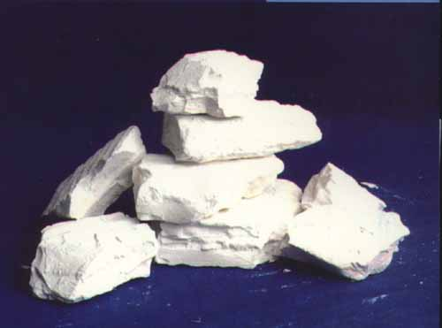
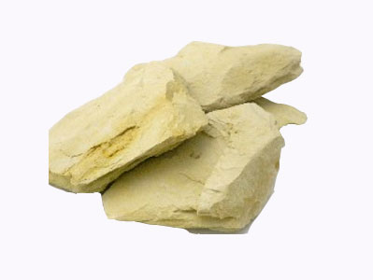
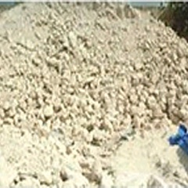
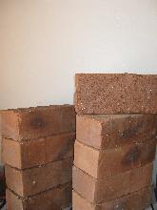
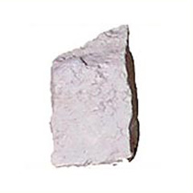
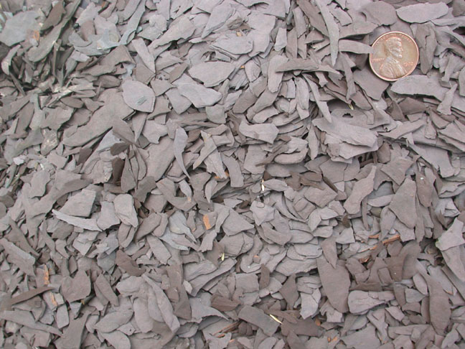
Clays are categorized into six groups , The categories are
(1)Kaolin or china clay (2)fuller’s earth
(3)ball clay (4)common clay
(5) fire clay betonies (6)shale.

Slide 5
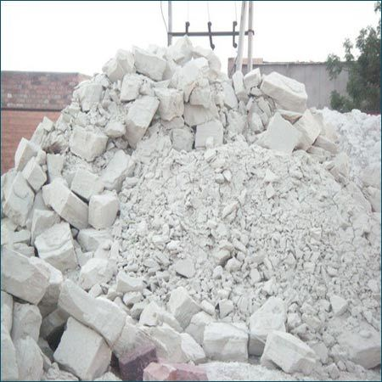
Kaolin is defined as a white, claylike material composed mainly of kaolinite,
which is a hydrated aluminum
silicate (Al2O3·2SiO2·2H2O), and other kaolin-group minerals. ,
It is still used extensively in chemical industry as crucibles ,jars and components of chemical reactors.

Slide 6
Processing of clay materials
The processing consist of following steps
1.Preparation of powder
2.Mixing and blending of power
3.Compacting of powder
4.Firing or Sintering

Slide 7
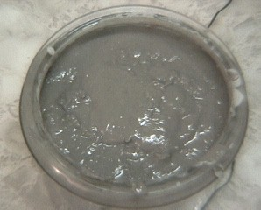
Preparation of powders
Natural ceramics are mined in open –pit mines whenever possible, and reduced to powder in crushers and hammer and ball mills.
Undesirable components are removed by screening ,magnetic separation ,filtering or floating.

Slide 8
Mixing and blending of powders.
The aims of mixing and blending are the same as in case of powder metallurgy .
A ceramics is mixed and blended with other ceramic/ceramics or with lubricants and binders.
In clay products are made by combining several different clay minerals (sio2,Al2o3 etc) with certain amount of non-plastic materials, such as crushed and ground quartz , feldspar, talc or gorg ,a finely ground fire clay material .
Non plastic materials, in general ,alter the plasticity of the clay body ,making it more suitable for various processes ,act as fluxes causing greater degree of vitrification during firing ,and reduce the drying and firing shrinkages of the clay body.
A wetting agent like water is added to improve the mixing

Slide 9
Compacting of ceramics
All the techniques employed for compacting powder can be used for compacting clay powders to the desired shape .
(1)Wet pressing
Here the percentage of blinder or addictives or liquids (water) is such the mixing can be processed by plastic forming technique .
The main limitation of pressing in die is that since the granular ceramic material is limited in its plasticity ,complex shapes in the lateral planes cannot be formed successfully.
(2) Jiggering
Jiggering is an automatic forming process.
It operates on the pattern of potter’s wheel .
The raw material is placed in a heavy mould, made of plaster of pairs.
The inside shape of the mould is the desired outside shape of the product.
The inner shape of the product is obtained by forcing a shaped tool into the material ,while the mould is rotated.

Slide 10
Firing or sintering
To get the desired strength of the product ,its fired or sintered
However , before it is fired or sintered ,it should undergo , a drying process by holding at room temperature and by low temperature heating
This is done to drive away any moisture of organic carrier ,there by minimizing the stress, distortion and cracking during the firing process
Then the compact is fired or sintered to obtain the desired level of strength, the firing process (slow heating and cooling) may take day or even weeks.

Slide 11
Heat resistant applications include: pyrometer tube, burner tips, and radiant heater supports.
Earthenware: apparent porosity is usually 6to 8% and may exceed 15%. Firing range is 800 to 950 c and may exceed 1000 c .typical applications are :porous drainage pipes, ceramic filter, wall tiles and bricks.
(b) Fine china :apparent porosity is usually less than 1%.Firing range is 1100 to 1200 c .topical product application :tableware.
(c) Stoneware: apparent porosity is less than 3% .it is usually 1 to 2% .firing temperature is above 1250 c.Typical applications are: glazed pipes, roofing tiles and tableware.
(d) Porcelain: Apparent porosity is less than 1% and is usually zero. Firing temperature is 1300 to 1450 c.Typical applications : Fine tableware, scientific equipment and spark plug insulators for automobiles.

Slide 12
Thank You

