Slide 1
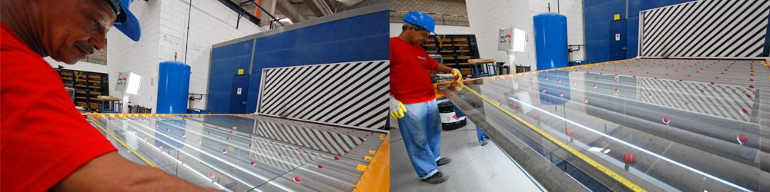
Heat treating glasses
PRESENTING BY
RINIL.N
S4-ME
10247

Slide 2
Introduction
This presentation focuses on heat treatment on glasses
It is designed to interpret the potential impacts of the processes associated with glass. It takes you through the cradle to grave lifecycle of glass.

Slide 3

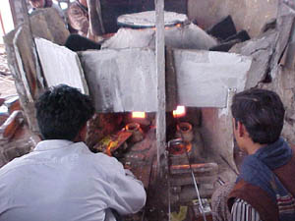
Historical Glass Manufacturing process:
Historical method:
heating and blowing
shape the glass products by hand
requires high skills & is time consuming
  therefore using glass is considered as luxury in our old world

Slide 4
Natural Resources
Silica sand 72%
Soda Ash 17%
Lime 5%
17%
5%
72%
6%

Slide 5
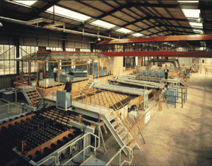
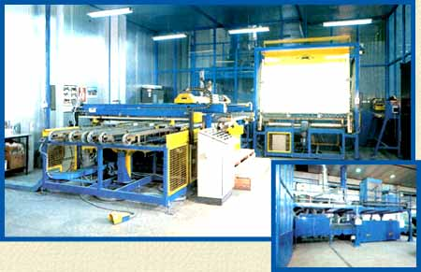
Development of Glass Making
First automated bottle machine was created in 1905
Nowadays, most of the glass containers are manufactured by technological machines at large, automated factories & control by computers
  cheaper and better
in quality
A Float glass
Plant

Slide 6
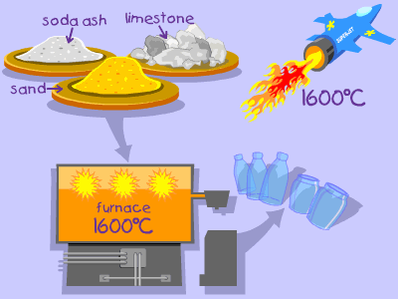
Today’s Glass Manufacturing Process:
Silica sand, limestone, soda ash and cullet (recycled glass or broken glass) are keep dry and cool in a batcher house in silos or compartments
Mixing and weighting into proper proportion
Send to furnaces in hoppers
  operated by natural gas
  heat the mixture at 1300-1600 degrees Celsius into soften or molten state

Slide 7
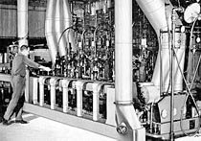
4. Molding --- molten glass flows to forming machine to mold into desire shapes
5. Annealing lehrs --- reheating the glass in an oven
  to ensure even cooling of glass for strengthening of the products
6. Cooling process --- Cool for 30 min to an hour for safe to handle.
7. Glass products are then decorated,
inspected again and finally packaged
and shipped to our customers.
glass furnace
cooling systems

Slide 8
Heat-Treated Glass Surfaces Are Different
Industry Cleaning Procedures Must be Followed to Avoid Glass Damage
As the use of glass increased over recent years, issues of strength, safety and thermal performance became increasingly important design considerations.
The availability of tinted and coated glasses
had a dramatic impact on glass use in building project

Slide 9
The vastly expanded aesthetic options,
combined with the improved energy conserving and comfort capabilities of tinted and coated glasses
allowed architects to use more glass, as well as larger sizes in their designs. A consequence of this
trend was a corresponding increase in the use of tempered and heat-strengthened glass in order to
meet both thermal and windload design requirements

Slide 10
TWO TYPES OF HEAT TREATED GLASSES
Currently, there are two types of heat-treated glass as defined in the American Society for Testing and Materials (ASTM) C 1048
The two types are heat-strengthened (Kind HS) and fully
tempered (Kind FT). Both types of glass are produced using the same equipment

Slide 11
Heat treated glass are classified into two types
1. Fully Tempered Glass
2. Heat Strengthened Glass
Fully Tempered Glass
Both fully tempered and Heat Strengthened glass is having the same heat treatment process and only difference is in the method of quenching. Higher airflow rates produce fully tempered glass.

Slide 12
Characteristics of fully tempered glass
Fully tempered glass is approximately 4 times stronger than the normal annealed glass and 6 times thermal resistant to that of annealed glass. It can be used up to a working temperature of 300Degree Celsius. Tempered glass is also able to resist temperature differences of 100 to 150 Degree Celsius which could cause annealed glass to crack. Typically breaks into small particles which are normally non-injurious and can be used as safety glass. It can be laminated with a suitable number of PVB interlayer. It can't be cut or drilled after tempering. Since tempering improves the structural property. Tempered glass is considered as a structural element and it can be used for frameless glass facades, doors and point support systems and also can be used with any type of windows and curtain walls.

Slide 13
. A majority of the heat-treated glass produced over the last 30 years has been fabricated in horizontal roller hearth
heat-treated glass produced over the last 30 years has been fabricated in horizontal roller hearth furnaces

Slide 14
PRINCIPLE OF HEAT TREATMENT
The basic objective of heat treatment process is to create an initial condition of surface and edge compression
achieved by first heating the glass, then cooling the surface rapidly
This causes the center of the glass to be hotter than the surface rapidly.
As the center cools it forces the surfaces and edges into compression

Slide 15
Therefore such glasses can be Brocken only after overcoming this compressed extra surface.
The heat treated glass is fractured into small relatively harmless pieces by the tensile forces released from the glass center core and this phenomenon of breaking glass into small particle is called dicing.

Slide 16
PREPARATION STAGES
The preparation stage for the heat-treatment process requires annealed float glass to be cut to the required final size
the edges to be treated according to the specified finish (commonly seamed or polished) and the glass to be washed
The process then requires the glass to be transported on horizontal rollers through an oven and heated to approximately 1,150º F (621º C).

Slide 17
There are two principle manufacturing method for heat treatment
One process heat treat it in a horizontal position while the second method moves the glass through the furnace in a vertical position with each light held by metal tongs
It is then heated to approximately 650 Degree Celsius. Upon withdrawal of hot glass from the tempering furnace, it is rapidly cooled (quenched) by blowing carefully controlled air flow from fixed or reciprocating or rotating blast nozzles uniformly onto both surfaces of glass simultaneously.

Slide 18
Higher airflow rates produce fully tempered glass having a surface compression of 700kg/m2 or more and an edge compression of 680 or more and much lower air flow rates produce heat strengthened glass having a surface compression between 250 to 700kg/m2 and an edge compression between 390 to 680 kg/m2

Slide 19
RESPONSE OF PROPERTIES OF GLASSES AFTER HEAT TREATMENT
Upon exiting the furnace, the glass is rapidly cooled (quenched) by blowing air uniformly onto both surfaces simultaneously. cooling process leaves the surfaces of the glass in a state of compression and the central core in compensating tension
The color, clarity, chemical composition and light transmission characteristics of glass remain essentially unchanged after heat-treating

Slide 20
. Likewise, hardness, specific gravity, expansion coefficient, softening point, thermal conductivity, solar optical properties and stiffness remain unchanged by the heat-treating process.
The only physical properties that change are improved flexural and tensile strength, and improved resistance to thermal stresses and thermal shock

Slide 21
Under uniform loading, heat-treated glass is stronger than annealed glass of the same size and thickness.
The heat-treating process does change the
break pattern of the glass, i.e. fully tempered glass disintegrates into relatively small pieces meeting the safety glazing requirements and thereby greatly reducing the likelihood of serious cutting or piercing.

Slide 22
INJURIES
As mentioned, the heat-treating process typically involves the transport of very hot glass on rollers.
As a result of this soft glass-to-roller contact, some glass surface changes will occur

Slide 23
APPLICATIONS
Uses of Tempered Glass
Tempered is using widely in Construction Industry for windows, curtain walls, frameless structural glazing work, sky lights etc were applications requiring increased strength and safety.
It also using in automotive industry as side and rear windows in automobiles.
It is also find application in refrigerators, furniture, ovens, shelving etc.
Tempered glass should not be used were building codes require wired glass for fire resistance

Slide 24
Thank you…..

