Slide 1
ELECTROLYTIC GRINDING
ManuRaj T V
Roll No. 26
S4 ME
GCEK

Slide 2
Introduction
In Electro-Chemical Machining (ECM) the principle of electrolysis is used to remove metal from the work piece, ie , When two dissimilar metals are in contact with an elecrolyte the anode losses metal to cathode.
In ECM, Work – anode & Tool – Cathode
Therefore work losses the metal, but before it can be plated on the tool, the dissolved metal is carried away in the flowing electrolyte.

Slide 3
Grinding is the metal cutting operation performed by means of rotating abrasive wheel, called grinding wheel, that act as cutting tool.
Grinding wheels are made of fine grains of abrasive materials held together by a bonding material, called a bond. Each individual and irregularly shaped grain act as a cutting element.

Slide 4
ELECROLYTIC GRINDING or
ELECTRO-CHEMICAL GRINDING (ECG)
Work is machined by combined action of electro-
chemical effect & conventional grinding operation.
Majority of the metal removal results from the
electrolytic action.
90% of metal is removed by electrolytic action &
10% by abrasive grinding.

Slide 5
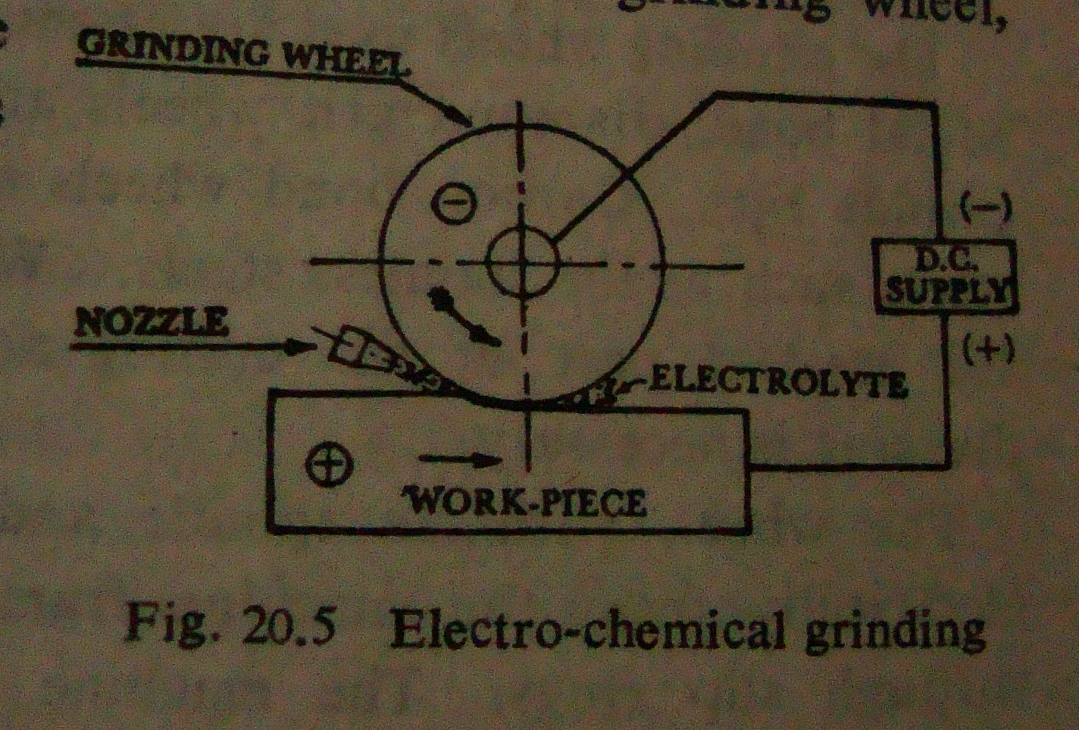

Slide 6
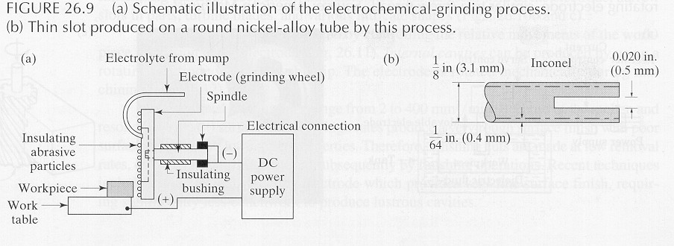

Slide 7
The tool electrode is a rotating metal bonded
diamond or aluminium oxide wheel, which act as
cathode.
Work act as anode.
Current flows between work and wheel.
A constant gap of about 0.25mm is maintained
between work & wheel & through this gap , a
neutral electrolyte is circulated. The electrolyte is
carried past the work surface at high speed by the
rotary action of the grinding wheel.
Grinding wheel runs at speeds of 900 to
1800m/min.

Slide 8
Functions of abrasive particles:
Act as insulators to maintain small gap between wheel & workpiece
Remove electrolysis product from the working area.
To cut chips if wheel should contact the workpiece particularly in the event of power failure
The abrasive particle rub against the workpiece, scrubbing of the electrolysis product, thus allowing good dimensional control.

Slide 9
Surface finish, precision & metal removal rate are
influenced by the composition of electrolyte.
Metal removal rate is directly proportional to pressure
between wheel and workpiece.
Accuracy : 0.01mm
Surface finish : 0.1 micrometre Ra
Metal removal rate : 15mm³/s
Electrolytes used : Aqueous solution of sodium silicate ,
borax, sodiun nitrate & sodiun nitrite.
Power supply: D.C voltage of 5 to 20 V, current density of
100 to 200 A/cm².

Slide 10
ECG is used for workpiece sensitive to the heat of the usual
grinding methods.
Used for shaping and sharpening of carbide tools.
Also used for processing of refractory metals, high-strength
steels, nickel & cobalt base alloys.

Slide 11
Advantages over conventional grinding operation
Tool wear is negligible which greately increases the life of the grinding wheel
It produce a smoother surface and does not produce surface stress & distortion
ECG is much more rapid than ordinary grinding
Requires very light grinding pressure & eleminates thermal problems
Delicate parts can be machined without distortion
Can machine burr-free parts

Slide 12
Disadvantages
Higher cost of grinding wheel
Higher cost of maintanance
Tolerance achieved are rather low, thus workpiece need final abrasive machining
Difficult optimization , due to complexity of the process

